Slide 1
CITIZENS' ENGAGEMENT IN HEI CURRICULUM: IMPLEMENTATION OF A SERVICE-LEARNING APPROACH - experience from University of Zagreb, Croatia –
UNIC CityLab
Koraljka Modić Stanke & Ana Opačić
November 10th 2022

Slide 2
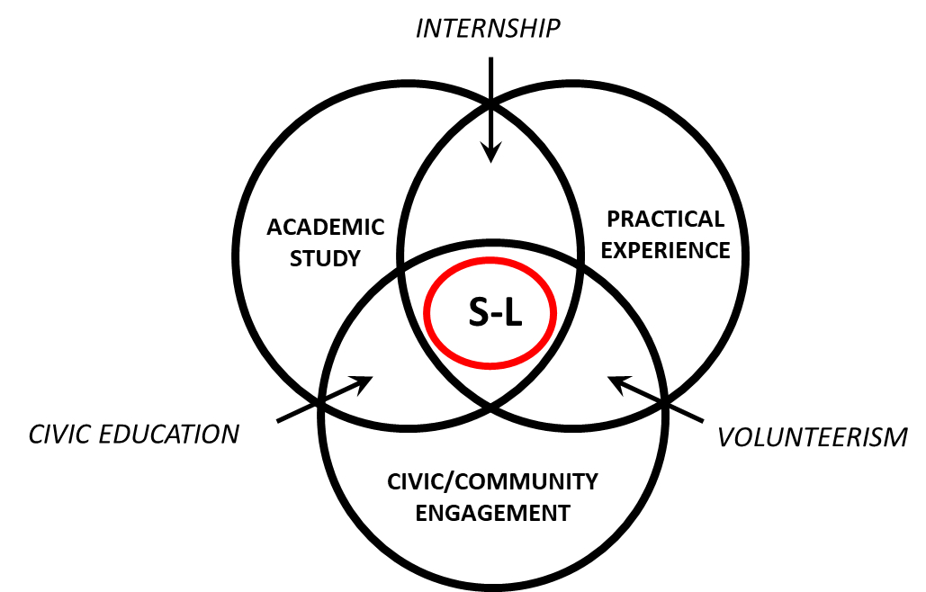
Introduction
„Service-Learning (S-L) is an innovative pedagogical approach that integrates meaningful community service or engagement into the curriculum and offers students academic credit for the learning that derives from active engagement within community and work on a real world problem.
Reflection and experiential learning strategies underpin the process and the service is linked to the academic discipline” (McIlrath et al., 2016, p. 5)
Figure 1. Service-Learning elements (Ismail, 2007)

Slide 3
Introduction
„Service-Learning (S-L) is an innovative pedagogical approach that integrates meaningful community service or engagement into the curriculum and offers students academic credit for the learning that derives from active engagement within community and work on a real world problem.
Reflection and experiential learning strategies underpin the process and the service is linked to the academic discipline” (McIlrath et al., 2016, p. 5)
Figure 2. Conceptual framework for S-L according to Ash and Clayton (2009)

Slide 4
Beginnings of S-L in Croatia
Nives Mikelić Preradović, Department of Information and Communication Sciences, Faculty of Humanities and Social Sciences, University of Zagreb
2005-06 Junior Faculty Development Program scholar at George Washington University (USA)
2006-07 introduced S-L at the Department of Information and Communication Sciences, Faculty of Humanities and Social Sciences, UniZG (as a substitute for the seminar part of a course)
2008-09 First stand-alone elective S-L course: Service-Learning in Information Sciences
from 2008 on-> numerous S-L workshops for scholars and county council members in the region
2012-13 S-L introduced at the Department of Social Work, Faculty of Law, UniZG within the course Basics of Counselling
2014-15 stand-alone S-L course Psychology of adoption introduced at the Department of Psychology, Faculty of Humanities and Social Sciences, UniZG

Slide 5
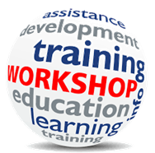
Beginnings of S-L in Croatia
Erasmus+ KA2 project Europe Engage - Developing a Culture of Civic Engagement through Service-Learning within Higher Education in Europe (2015-2017)
2017 - round table "Institutialization of service learning in higher education"
participants: Rector, Vice Deans, teachers and NGO representatives
the Rector of the University of Zagreb supports S-L and suggests establishing an S-L office that would coordinate S-L activities at the University level
ESF call for proposals “Support to the development of partnerships of civil society organizations and higher education institutions for the implementation of service-learning programs” (2018-2020)
General objective: increase the number of students with acquired practical knowledge and skills for solving specific social problems and community development
Specific objectives:
Strengthen the professional, analytical and advocacy capacities of civil society organizations through cooperation with HEI
Establish sustainable service-learning programs within HEI as part of a systematic approach to strengthening the social responsibility of teachers and students
over 150 eligible project proposals -> 27 granted projects

Slide 6
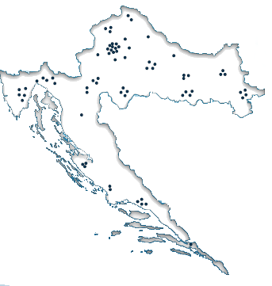
Beginnings of S-L in Croatia
27 projects dedicated to development of S-L were conducted in Croatia in the period from 2018.-2020. (Modić Stanke et al., 2020)
partnerships included more than 50 civic organizations and 35 HEI
over 50% of UniZG faculties were partners on one or more projects
over 120 S-L programs developed
over 1800 students participated
most projects provided S-L education for the participants
a lot of projects published some version of a S-L manual
2019. - establishment of the Office for Service-Learning in UniZG

Slide 7
How does S-L relate to UNIC?
UNIC MISSION: to revolutionize education and respond to the needs of our diverse populations as we co-create a unique study experience by structurally involving our students, research, staff, cities, civil society and urban companies in our university
UNIC VISION: ten years from now, our students and staff will study, teach and work throughout Europe and act as change agents who will play a role in the transformation of our urban regions of the future
UNIC encouraged further development of S-L courses (Faculty of Law):
Social Work in Organizing the Community
Service-Learning and Social Interventions
UNIC Service-Learning: Connecting University and Community

Slide 8
How does S-L relate to UNIC?
when introducing S-L for the first time, Mikelić Preradović (2009) recommends to start with:
projects in the final years of study, and
implementation of the method in an already existing course
however, connected with the values ​​and aspirations of the European University of Post-Industrial Cities (UNIC) we decided to pilot the method in the first year of study
2020-21 - elective course “Service-Learning and Social Interventions” was introduced to enhance the development of generic competencies of first-year social work students and to empower and encourage them for a more active engagement in the community
plan: evaluation + monitoring effects of S-L till graduation

Slide 9
How does S-L relate to UNIC?
“Service-Learning and Social Interventions” - findings related to the evaluation of in hybrid and full online mode (due to lock-down) presented by Modić Stanke et al. (2021) and Modić Stanke (2022)
students demonstrated significantly improved:
civic efficacy (greater improvement in hybrid S-L!),
social responsibility personal values,
participation skills
teamwork
civic action
interpersonal and problem solving skills
political awareness
cognitive flexibility

Slide 10
How does S-L relate to UNIC?
“Service-Learning and Social Interventions” - findings related to the evaluation of in hybrid and full online mode (due to lock-down) presented by Modić Stanke et al. (2021) and Modić Stanke (2022) :
implementation of S-L could help UNIC’s aim to be „superdiversity-ready”
particularly useful at the beginning of the studies, empowering and motivating students for community engagement
strengthening the university's civic mission
S-L group
control group

Slide 11
How does S-L relate to UNIC?
“Service-Learning and Social Interventions” – S-L project examples:
community partner Sunce (NGO specialized in education, counseling and providing support to families and individuals)
during 3 months, team of 4 students engaged in weekly activities with children with disabilities and their parents within the project „My right to sport”
students noticed some parents/children have the need for different organization of activities and conducted the research to provide NGO with information related to parents’ satisfaction with ongoing activities, obstacles that complicate their participation, and parents’ suggestions related to the way NGO can address their needs/needs of their children

Slide 12
How does S-L relate to UNIC?
“Service-Learning and Social Interventions” – S-L project examples:
community partner Mreža za beskućnike (NGO specialized in improving the care for the homeless, providing support and assistance and raising awareness about the homeless)
during 3 months, team of 5 students engaged in weekly activities with community partners and the homeless
students combined research (to determine the current state of awareness/knowledge in student population related to the homeless) with activities designed to raise public awareness about this issue
in front of the Student center

Slide 13
How does S-L relate to UNIC?
new course “UNIC Service-Learning: Connecting University and Community” within joint degree
in hybrid and/or full online mode
in co-creation with at least one UNIC University
international (teachers, students, community partners)
possibly interdisciplinary (but subjects related to psychology, pedagogy and/or social work)
preferably including engaged research
NOW WE WOULD LIKE TO HEAR FROM YOU…

Slide 14
How does S-L relate to UNIC?
new course “UNIC Service-Learning: Connecting University and Community” within joint degree
is S-L implemented in your university (if so – in what areas of study)?
are there any scholars that you think would be interested for co-creation?
what do you think will be the biggest challenge related to international partnerships?
would you include all students in engaged research or only a part of them (if so – based on which criteria)?
how would you raise UNIC students’, teachers’ and communities’ interest in S-L and engaged research?
NOW WE WOULD LIKE TO HEAR FROM YOU…

Slide 15
Literature:
Ash, S. L., & Clayton, P. H. (2009). Generating, deepening, and documenting learning: The power of critical reflection in applied learning. Journal of Applied Learning in Higher Education, 1, 25–48.
Ismail, N., Elias, S. (2007). Making a Difference: Serve to Learn. Academic Journal of Social Studies, 7(1), 1-14.
McIlrath, L. (Coord.)., Aramburuzabala, P., Opazo, H., Tuytschaever, G., Stark, W., Mikelić Preradović, N., Meijs, L. C. P. M., Mažeikiene, N., Zani, B., Vargas-Moniz, M., Millican, J., Northmore, S., Altenburger, R., De Bruyn, K., Hopia, A., Pessi., A. B., Grönlund., H. & Maas, S. (2016). Europe Engage Survey of Civic Engagement & Service-Learning Activities within the Partner Universities. Retrieved from https://europeengagedotorg.files.wordpress.com/2016/04/report-euen-mcilrath-et-al3.pdf
Mikelić Preradović, N. (2009). Učenjem do društva znanja – Teorija i praksa društveno korisnog učenja [Learning towards the society of knowledge – Theory and practice of service-learning]. Zagreb: Zavod za informacijske studije Odsjeka za informacijske znanosti Filozofskog fakulteta Sveučilišta u Zagrebu.
Modić Stanke, Mikelić Preradović, N., & Galešić, D. (2020, July). Development of Entrepreneurial Skills through Service-Learning. Paper presented at the Third European conference on service-learning in higher education of EASLHE, Bratislava.
Modić Stanke, K. Majdak, M., & Tomurad, I. (2021). Benefits and implications of a hybrid service-learning model. In L. Gómez Chova, A. López Martínez, & I. Candel Torres (Eds.), ICERI 2021 proceedings of the 14th international conference of education, research and innovation (pp. 740–748). IATED Academy.
Modić Stanke, K. (2022). Implementation of Service-Learning in the beginning of studies - benefits for individuals and the community. Paper presented at the 29. annual conference of Croatian psychologists „Psychology in the promotion of lifelong development, unlocking potential and strengthening the resilience of the individual and the community” of Croatian Psychologica Society, Tuheljske toplice.

