Slide 1
Environmental factors of Roma exclusion in the city area of Pešćenica - Žitnjak
Lea Kožul, Anđela Modrić, Lucijan Mimica i Juraj Turkalj

Slide 2
Roma population in Croatia
They have been living as a nation in Croatia for about 6 centuries
Today population = 30 – 40 thousand people (the real number is difficult to determine for several reasons)
Thruoghout their lifestyle, various aspects of exclusion were expressed but unfortunately today they are considered as marginalized in various aspects of life

Slide 3
Environmental factors
There are many groups and factors that contributes to marginalization, but group of factors we believe, cotributes the most to social isolation of Roma are environmental factors
Environmental group contains numerous of important and diverse factors
The research Kunac i sur. (2018.) made in Croatia shows complexity of their problem about social isolation

Slide 4
Kunac, S., Klasnić, K., Lalić, S. (2018). Inclusion of Roma people in Croatian society
The results that research showed were little expected but devastating
Research was done in 128 places in Croatia and participants were Roma that are living in that areas
The results revealed that 41 places (of 128) are separated from cities or villages where other citizens live and what is worse – traffic connections and infrastructure between cities and those isolated places are questionable quality (the roads are full of holes and not concreted, lack of pavements) and some participants said that they do not have road connections with other places which is concerning
Another aspect of environmental factors is the question of their legal rights to their homes (problem of illegal lands and illegal constructions where they are building their homes) – 11, 9 % of properties are not in process of legalization

Slide 5
Kunac, S., Klasnić, K., Lalić, S. (2018). Inclusion of Roma people in Croatian society
One more aspect of environmental problems that Roma people have is questionable interior of the house they live in – research found out that many households have problems with electricity, water and sewerage system
Considering everything, conclusion of researchers is that 59,2 % of their households are in housing deprivation which is worrying
Except difficulties with electricity, water and sewerage system, there are also issues with having a bathroom, shower and that large number of people have bathroom outside their homes
Another environmental problem are issues with garbage, waste disposal and polluted air due to issues that are already said
They are not informed, they do not have adequate resources and nothing is done about their garbage disposal and polluted air

Slide 6
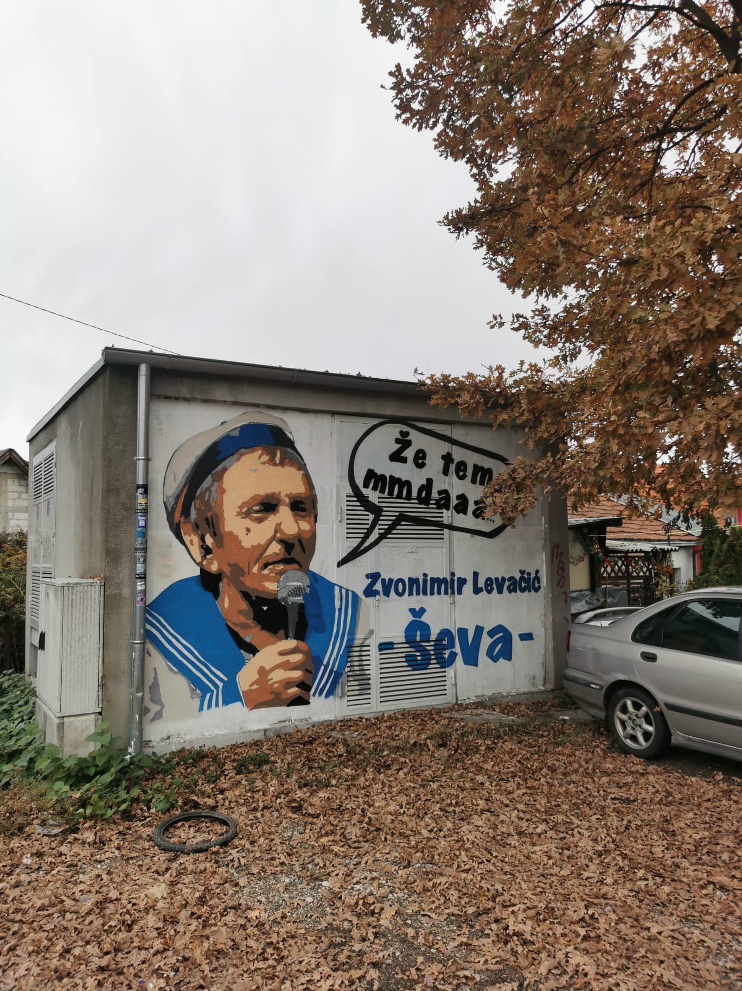
Zagreb, Pešćenica-Žitnjak
the second most populated county in terms of the number of in the Roma population
the number of Roma population in the city of Zagreb - 2,755
Pešćenica-Žitnjak - city quarter that is most represented by members of the Roma national minority
a series of environmental and infrastructural challenges

Slide 7
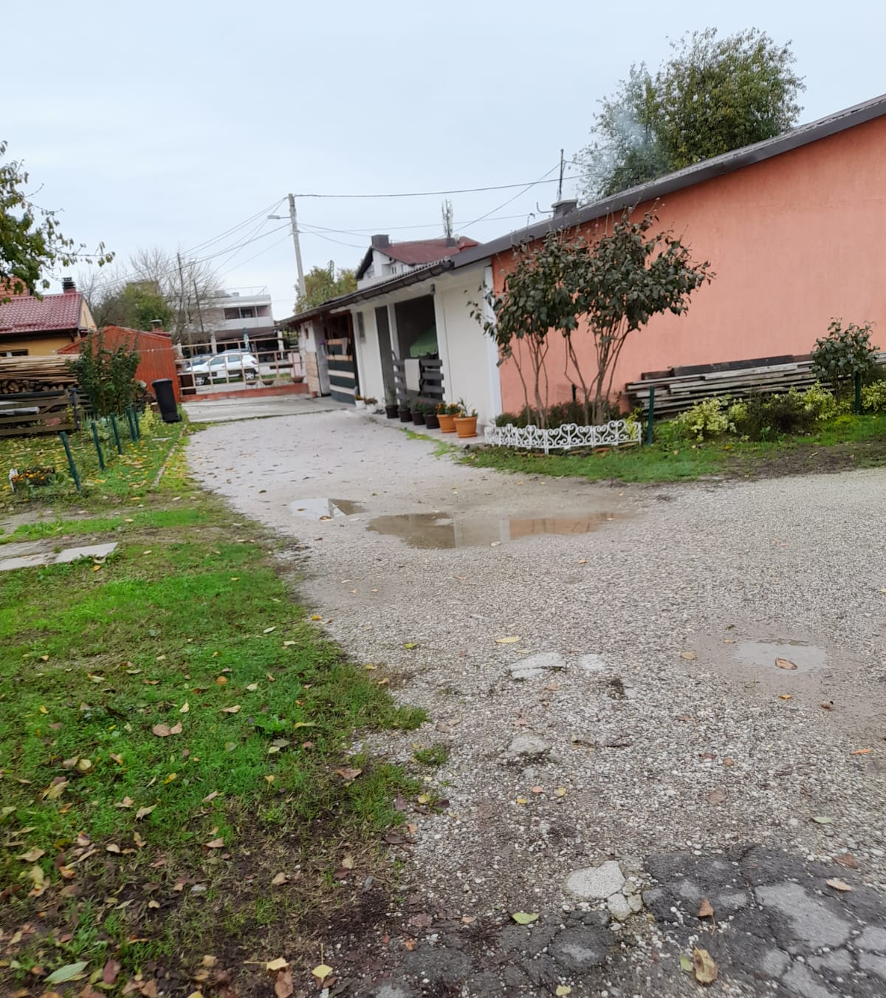
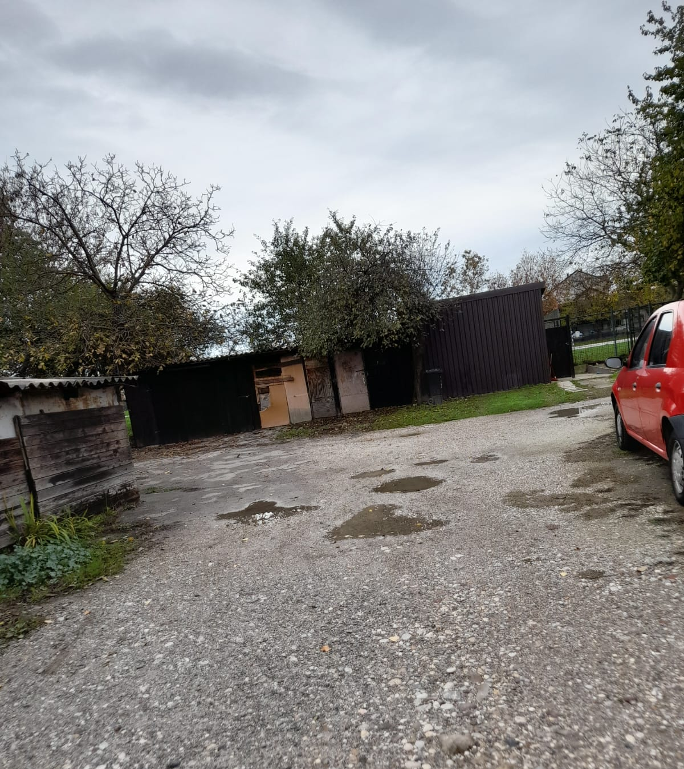
Roads and waste disposal
the roads are full of potholes, they are not paved
certain localities do not have an access road to the settlement
roads do not contain crosswalks and sidewalks for pedestrians
Donje Svetice, Ferenščica and Folnegović's village are the only well-connected parts of the city

Slide 8
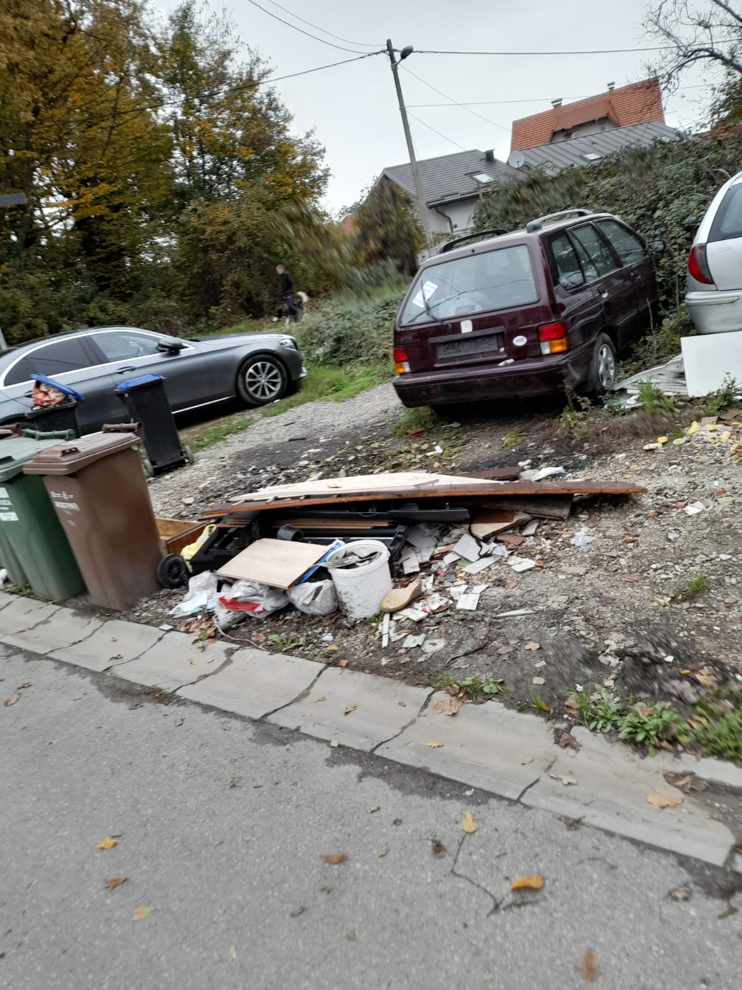
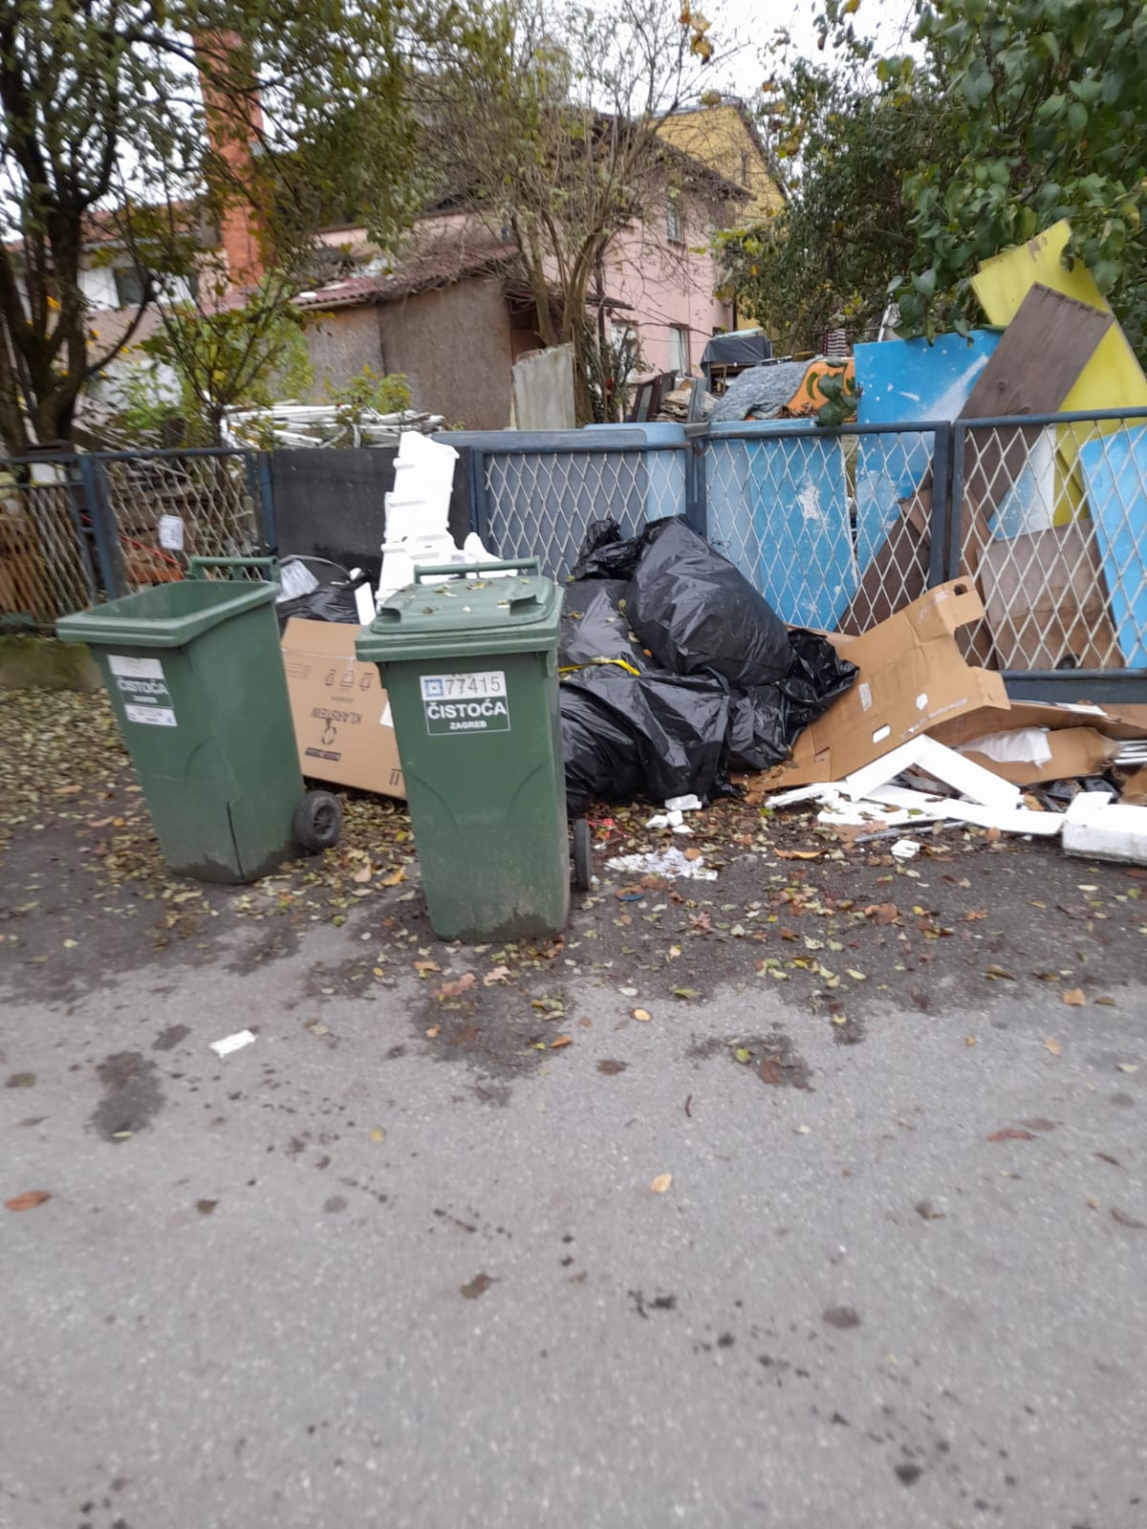
environmental conditions and factors that are dangerous to health, such as garbage, polluted air and bulky waste
the largest share of Roma people points out that the problem of waste disposal has remained the same and that no changes have been made in this regard (Kunac i sur., 2018)

Slide 9
Educational facilities and sport objects
in the area of the Kozari Putevi, Žitnjak (Roma settlement) and Ivanja Rekla local boards – 0 kindergartens
lack of places in primary schools
Sport objects → spatially unevenly distributed

Slide 10
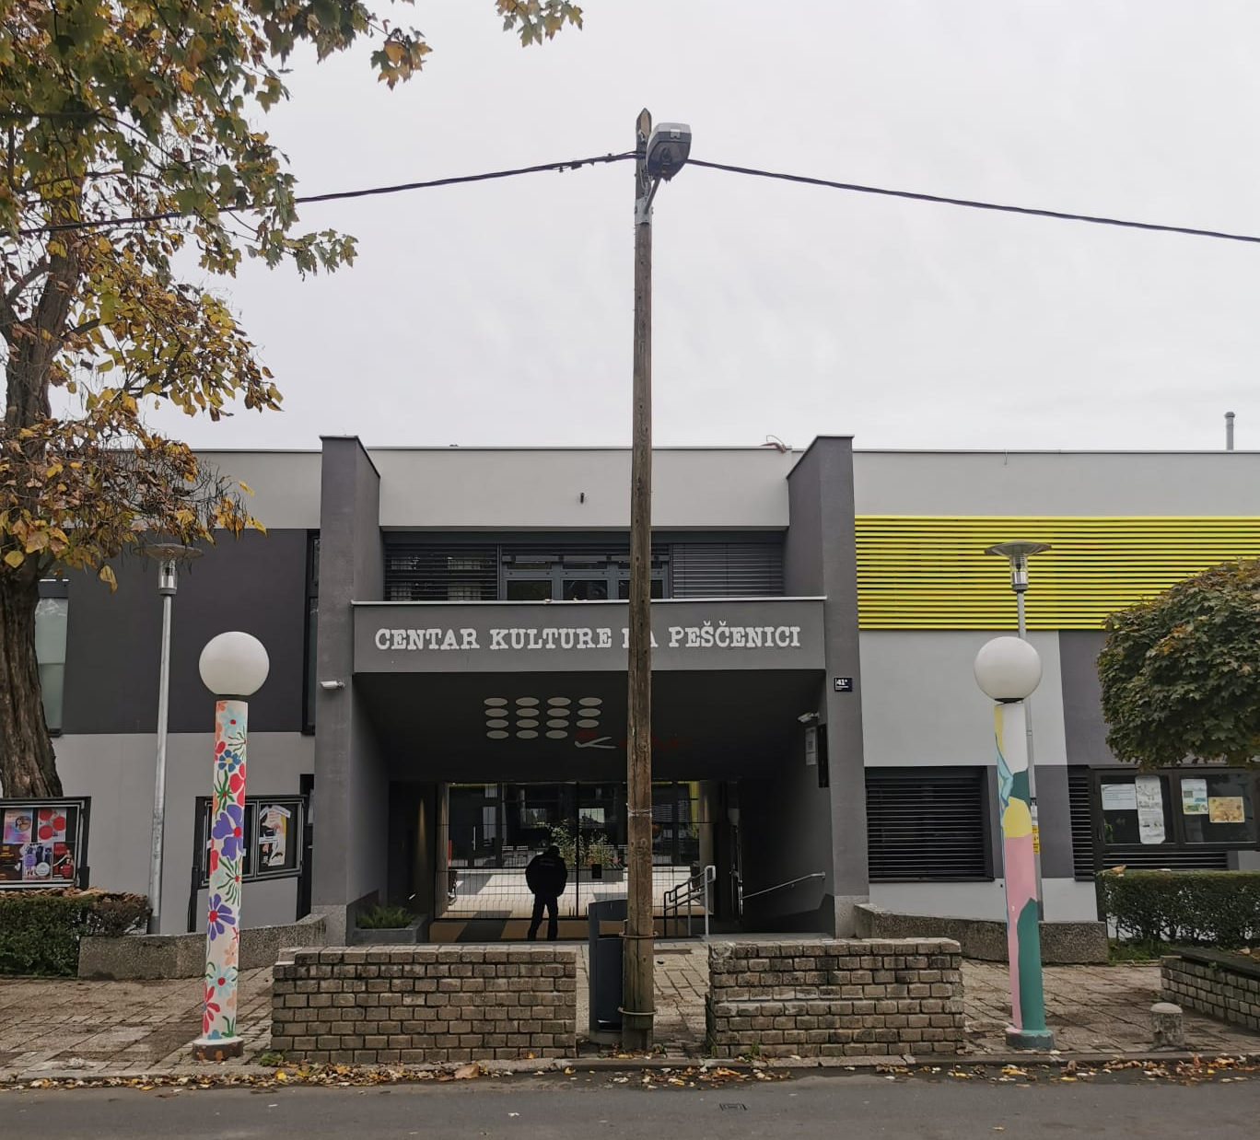
The cultural center on Pešćenica
the only cultural object in the area

Slide 11
Literature
Kunac, S., Klasnić, K., Lalić, S. (2018). Uključivanje Roma u hrvatsko društvo: istraživanje baznih podataka. Zagreb: Centar za mirovne studije.
Ured za ljudska prava i prava nacionalnih manjina (2012.) Nacionalna strategija za uključivanje Roma za razdoblje od 2013. do 2020. godine.

