Slide 1
EFFECTS OF TRAFFIC PROBLEMS ON DAILY LIFE OF CHILDREN WITH DISABILITIES AND THEIR FAMILIES
Students: Lucija Jezernik, Antonia Brajković, Lorena Burčul, Silvija Grahovac
Professor: prof.dr.sc. Ana Opačić
Social work in the community,
Study center of social work
Zagreb Faculty of Law

Slide 2
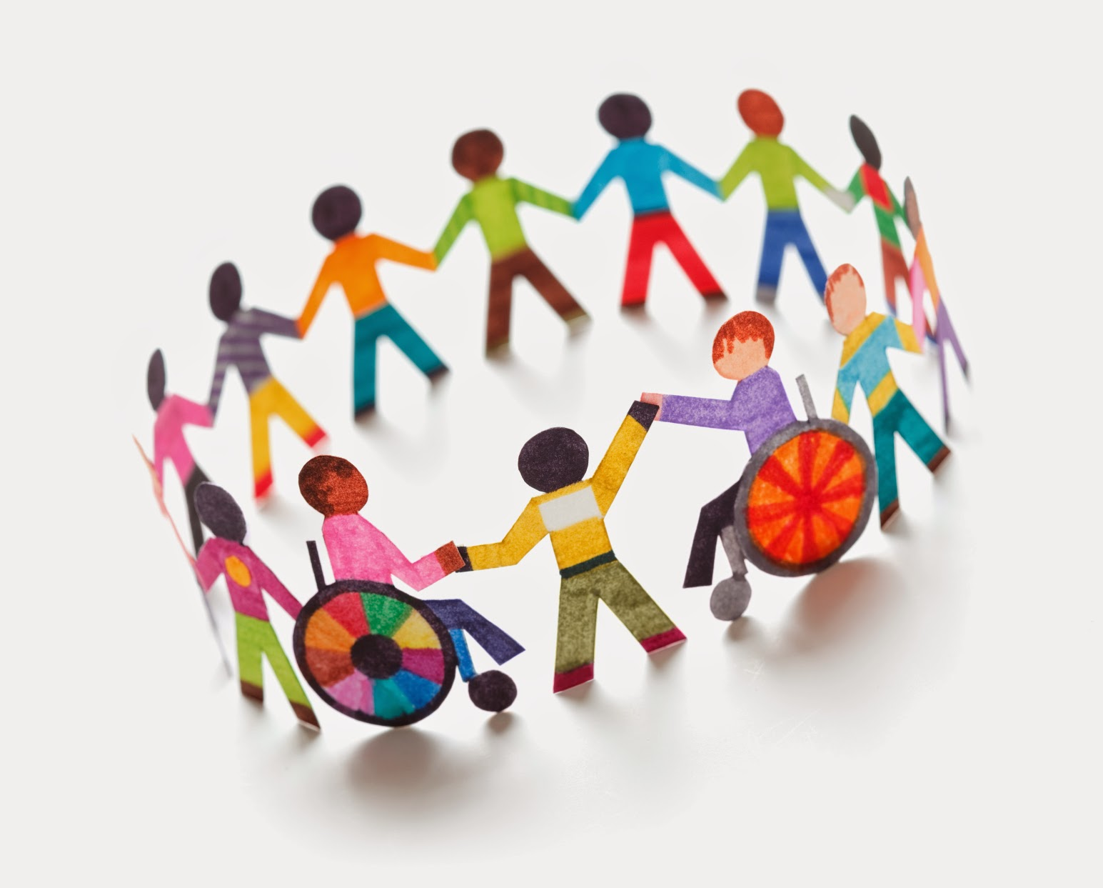
CONTECTS TABLE
Introduction
Needs and problems in the community
Available resources to improve the situation
Existing initiatives, actions and projects
The central problem of traffic
General goal
- specific goals
Potentional outcomes for specific goals
Carrying out activities for goals
conclusion

Slide 3
INTRODUCTION

Slide 4
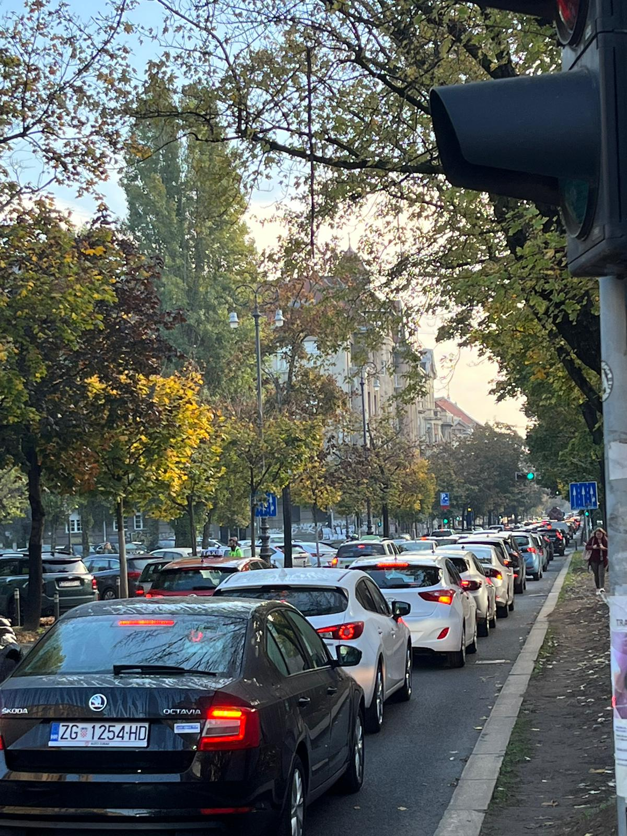
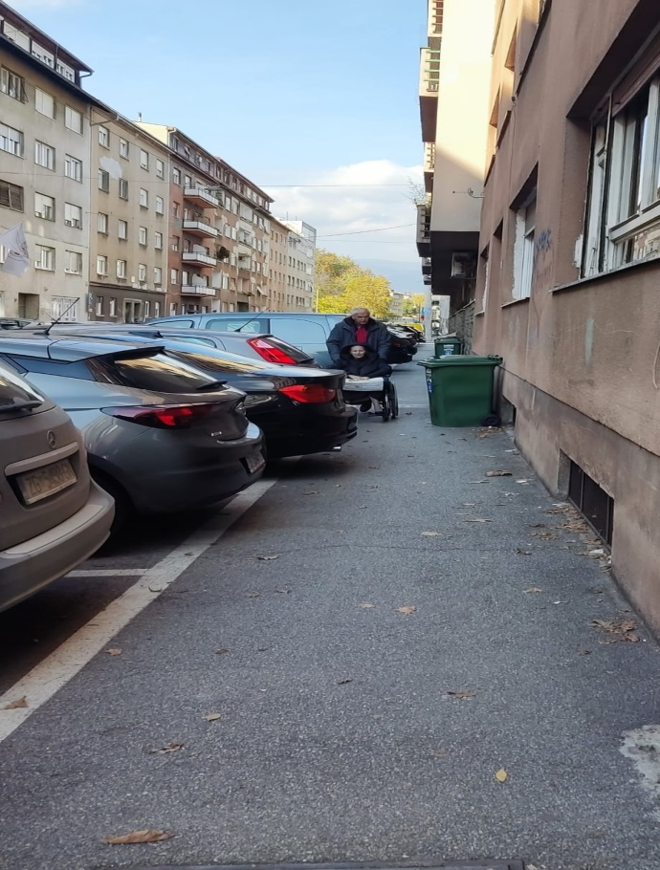
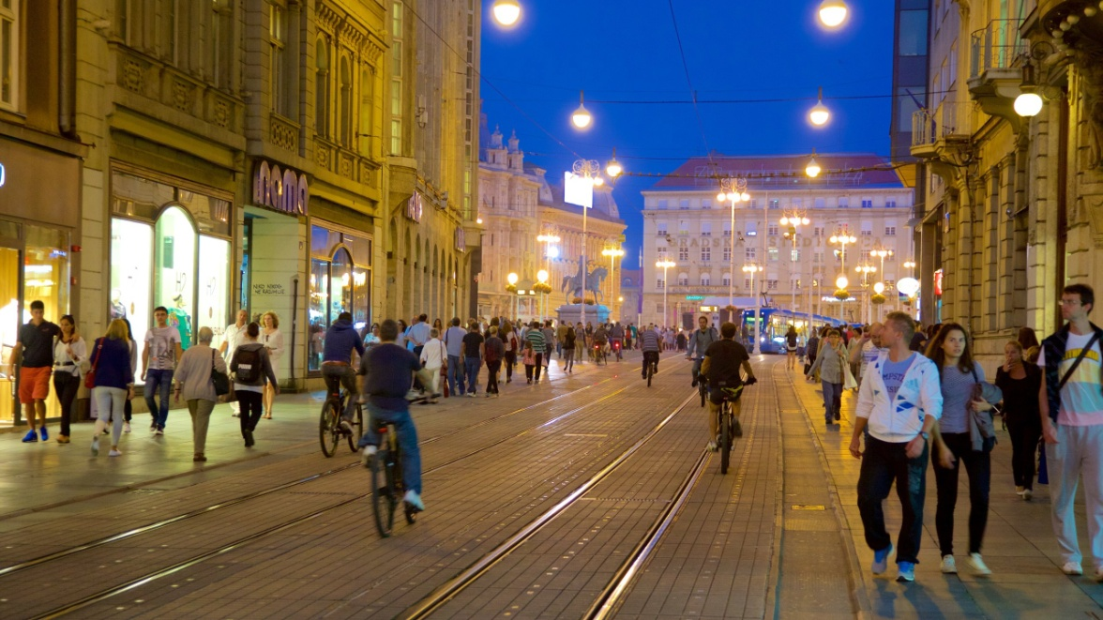

Slide 5
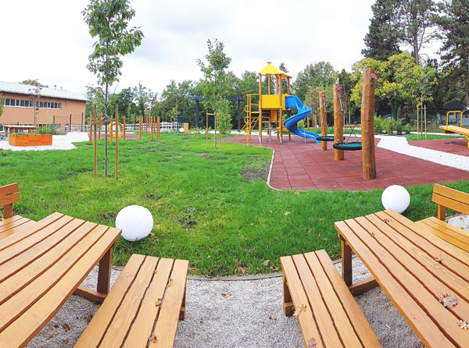
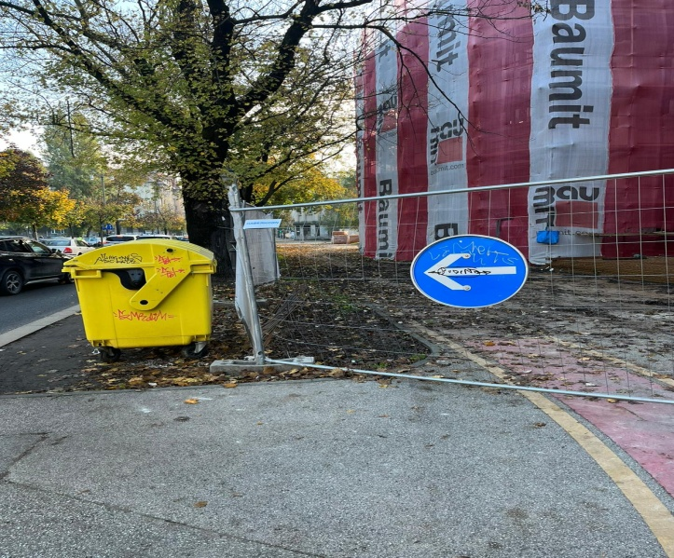
AVALIABLE RESOURCES
ASSOCIATIONS SPECIALIZED FOR CHILDREN WITH DIFFICULTIES
INSTITUTIONS FOR CHILDREN WITH DIFFICULTIES
ADJUSTMENT OF TRAFFIC

Slide 6
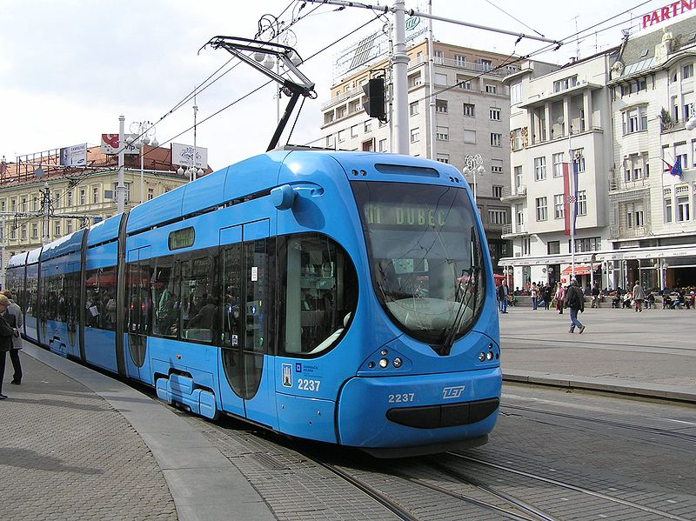
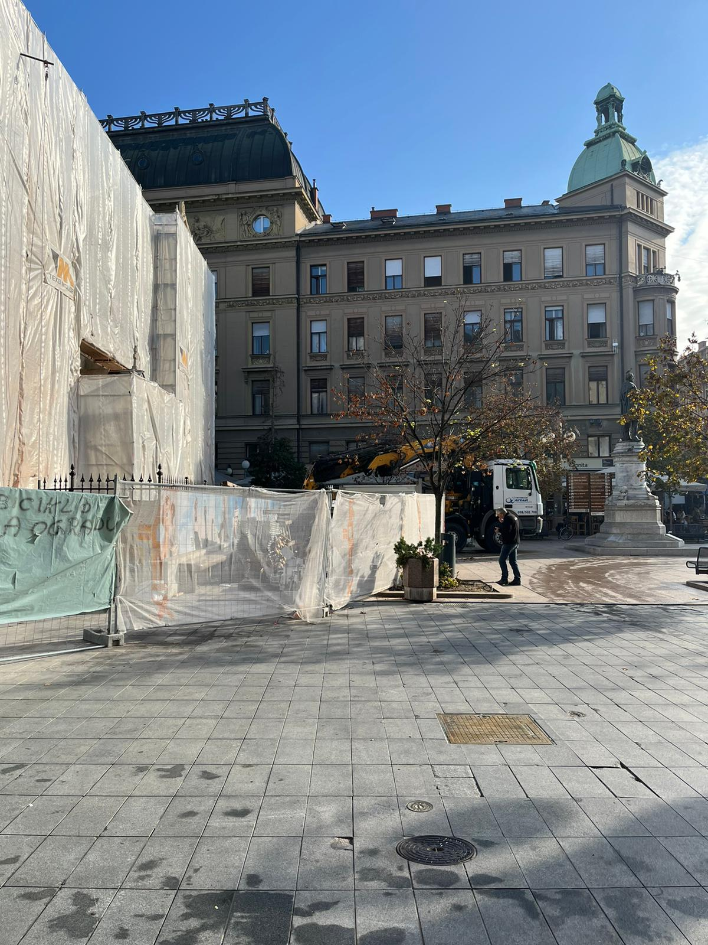

Slide 7
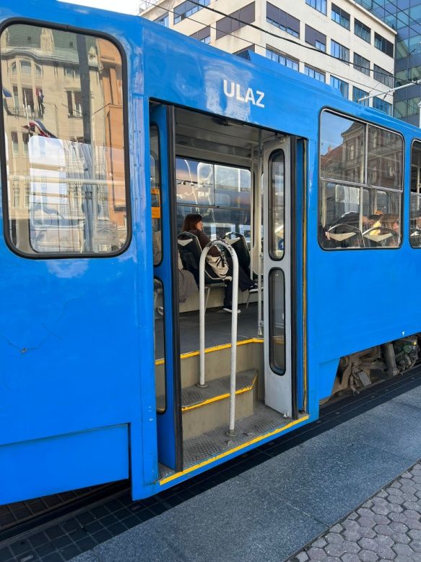
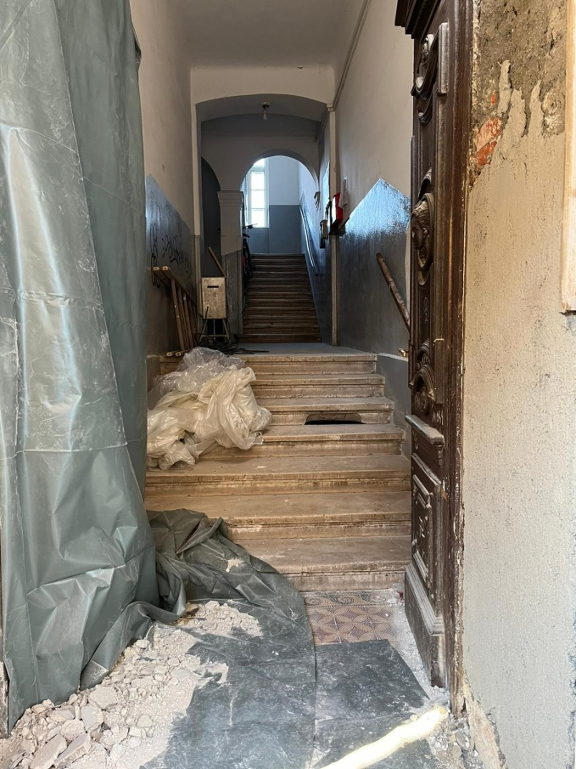
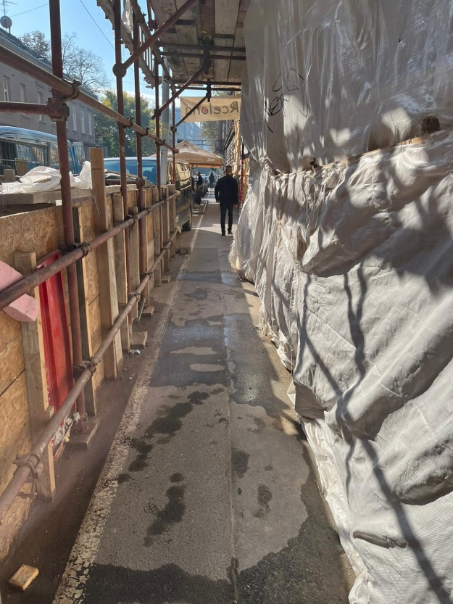
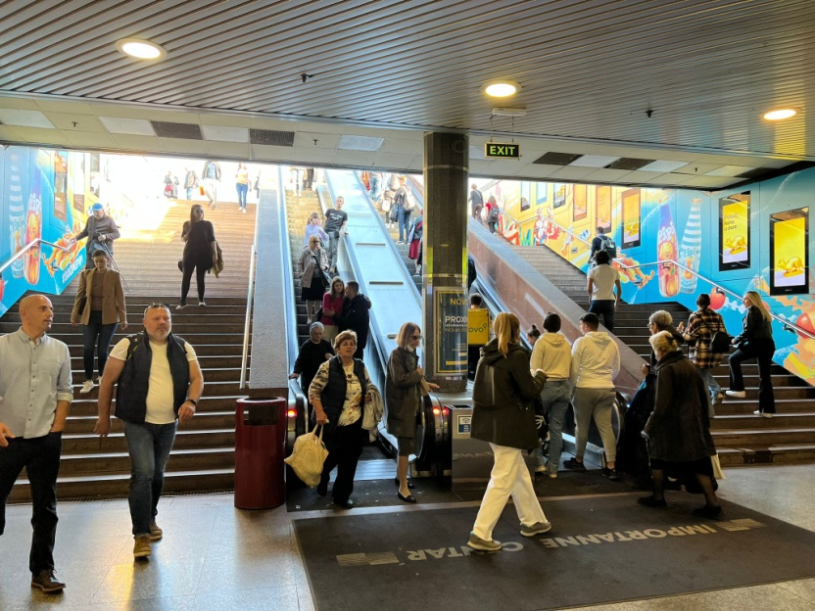
THE CENTRAL PROBLEM OF TRAFFIC
Narrow and inaccessible streets
Lots od light and noise
Insensitivity of citizens in traffic
Lack of knowledge and information

Slide 8
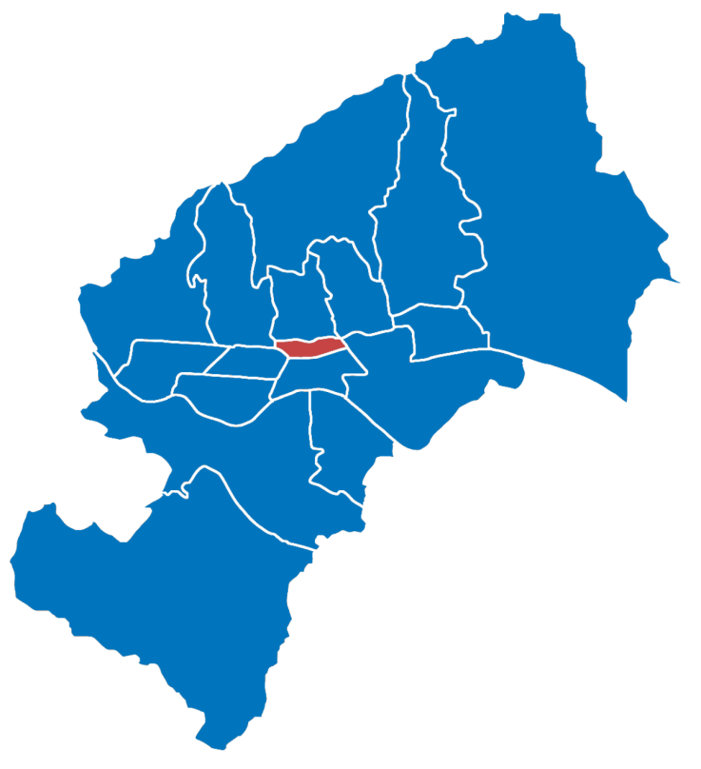
MAIN GOAL: Improve the mobility of children with disabilities
ensure accessibility to public areas
Participatory and inclusive planning of piublic transport
Education of citizens about traffic culture for families with children with disabilities
Imrpove the skills of parents and children with disabilities for safe movement in traffic
Notes:
Kolovoz 1990.

Slide 9
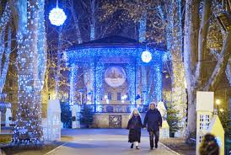
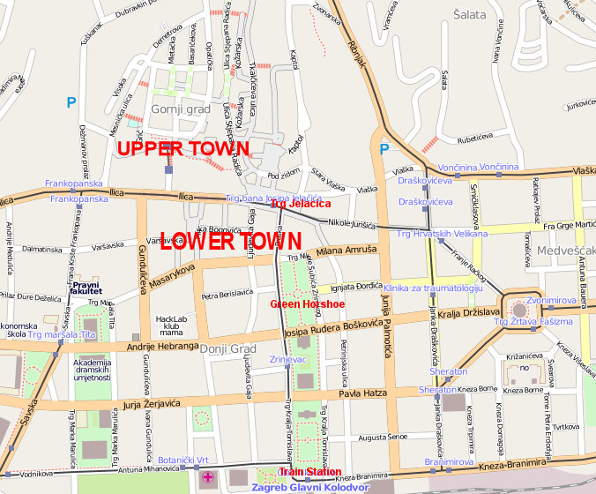
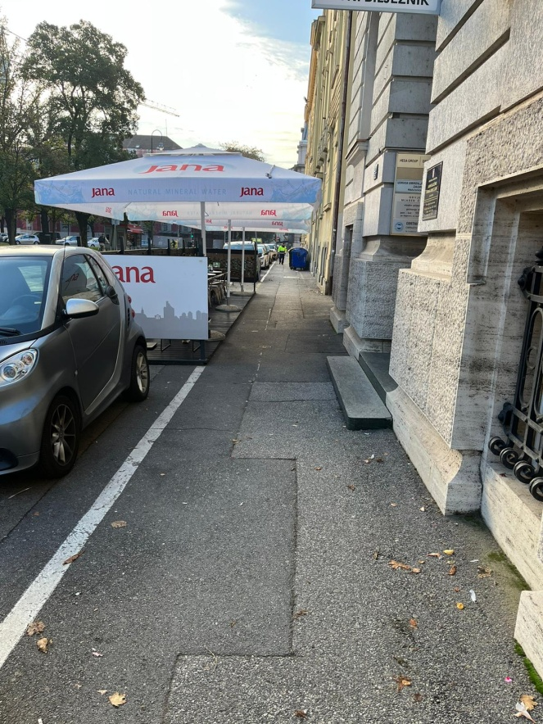
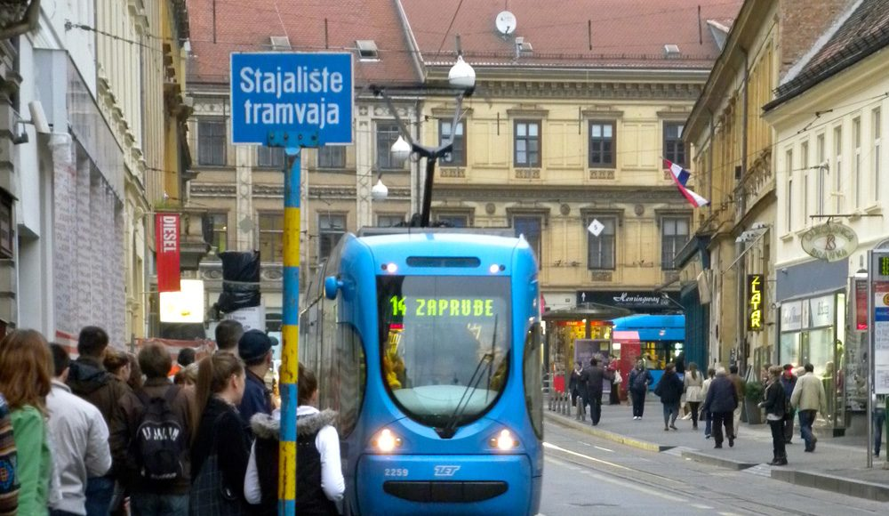

Slide 10
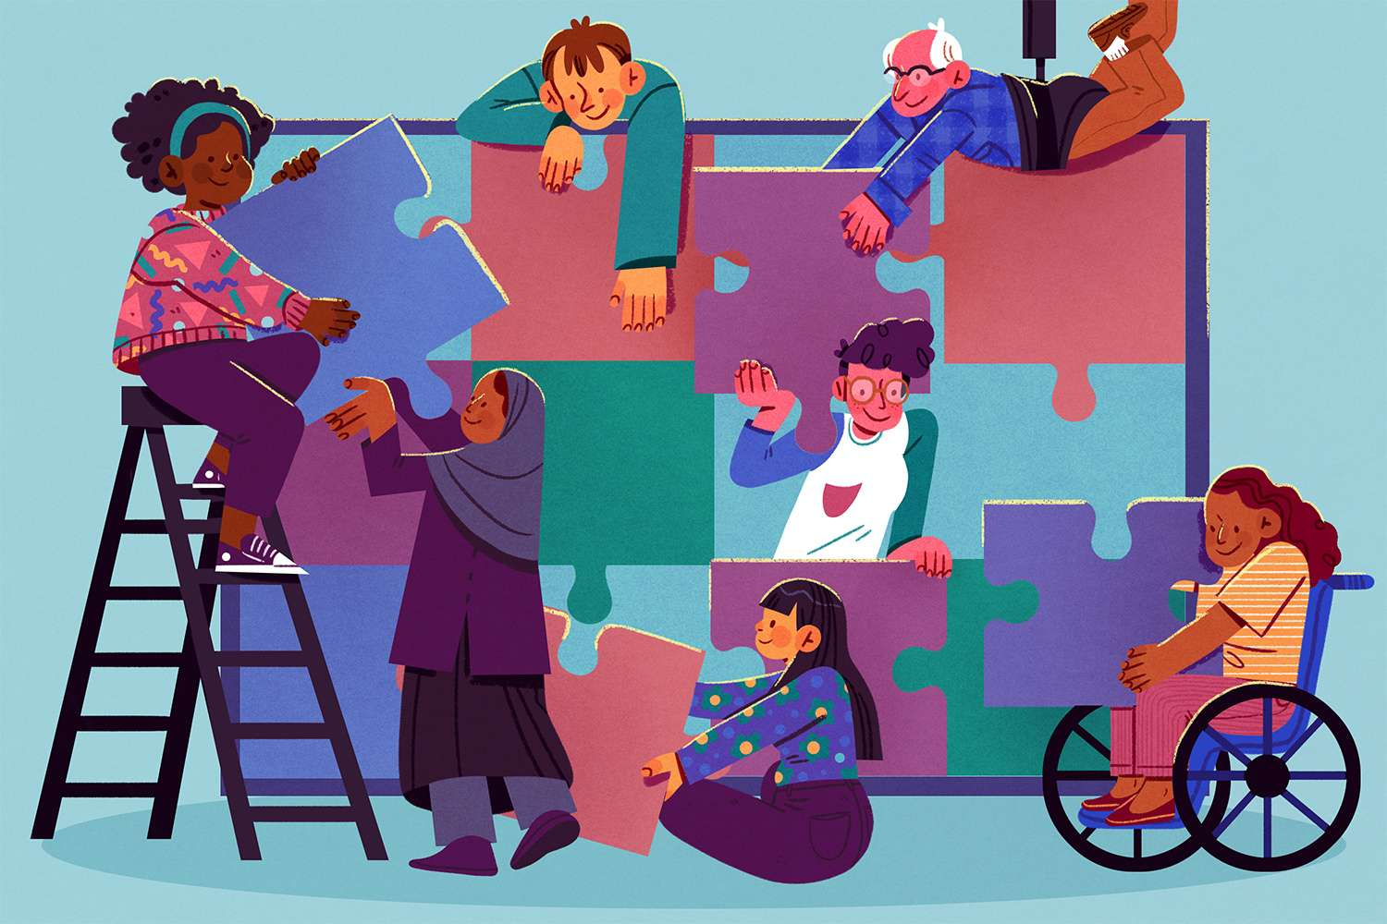

Slide 11
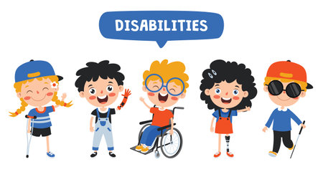

Slide 12
THANK YOU FOR YOUR ATTENTION!

