Slide 1
WASTE DISPOSAL PROBLEM IN ROMA COMMUNITY IN CITY DISTRICT OF PEŠČENICA-ŽITNJAK
Anđela Modrić, Lea Kožul, Juraj Turkalj, Lucijan Mimica

Slide 2
PROBLEMS FROM ENVIRONMENTAL DIMENSIONS
Housing problems
Infrastructure problems
The problem of waste disposal
Lack of institutions

Slide 3
AVAILABLE RESOURCES
LOTS OF UNUSED GREEN AREAS
COOPERATION WITH LOCAL COMMITTEES
VOLOVČICA MARKET
CITY REGIONAL OFFICE

Slide 4
INITIATIVES, ACTIONS AND PROJECTS
SOCIALLY INVOLVED ROMA COMMUNITY
MOJA VOLOVČICA
UNION OF ROMA
KAP DOBROTE

Slide 5
Choosing the most extensive and widespread problem
There are many environmental factors that contributes to the exclusion of Roma community in city district of Pešćenica-Žitnjak
It is not an easy job to decide which problem (in terms of environmental component) is the most destructive and contributes the most to the unsatisfactory placement of Roma community members
In the explanation, it is important to emphasize that all of the indicators of environmental problems are interconnected and intertwined, and unfortunately one leads to another

Slide 6
Inadequate disposal of communal waste
The problem we decided to deal with and to work on is the problem connected with waste disposal
It is crucial to highlight that problem of garbage disposal is problem that are facing all the citizens of Zagreb, and it is recognised by the authorities as massive problem
At this moment, there are no easy and effortless ways and strategies for this problem

Slide 7
Inadequate disposal od communal waste
This problem is seen as issue by the authorities of Grad Zagreb but also by the citizens of city district Pešćenica-Žitnjak that includes Roma community and everyone else that lives in that dictrict
Complexity and long term dealing with waste disposal in Zagreb goes far into the past, which can be seen primarly from research-based article, made by Željka Šiljković and the subject is The Problem of Waste Disposal in the City of Zagreb written in 1992.

Slide 8
Problem of waste disposal from citizens perspective
The first problem which we determined in inadequate waste disposal is primarly that there are many questions that people are asking, and the authorities do not have adequate and logical answers and solutions
politicians that are participating in leadership of Zagreb made a plan of waste disposal, but implementation is full of dificulties and complications (example for this is new bags for mixed waste disposal, that are mandatory to buy, but are really expensive and many people can not afford to buy them)
The plan that Grad Zagreb made is logical in theory, but really hard to implement

Slide 9
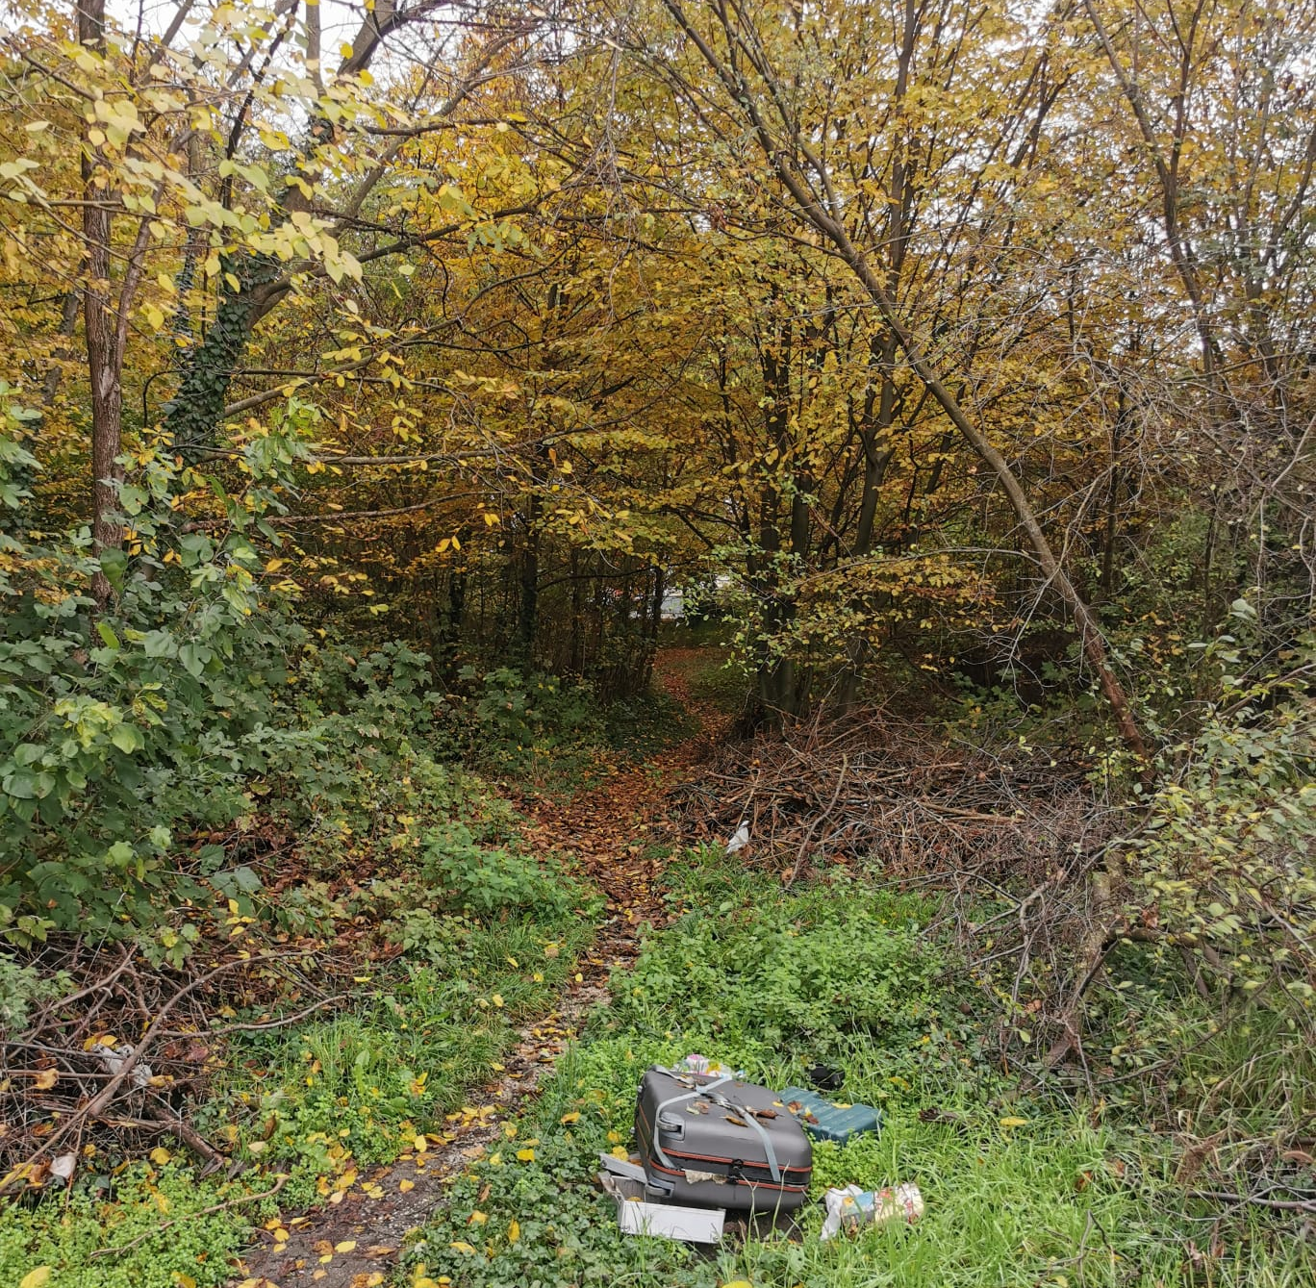
Connection of waste disposal and quality of life
The garbage is thrown on the streets, not even in the trash cans, other people place their garbage in their yards, some of them let the garbage in their houses and rooms where they live, and some of them just throw it in the nature, as we will show in next slide
Regardless the places where people throw garbage, whether if it is in the nature or anywhere else but the strictly stated places is big problem for quality life of citizens
This problem is really noticable and visible just by walking or driving trough this neighborhood, so it is huge aesthetic problem
Besides aesthetic problems, there are bigger consequences such as air pollution, destruciton of green areas and health problems

Slide 10
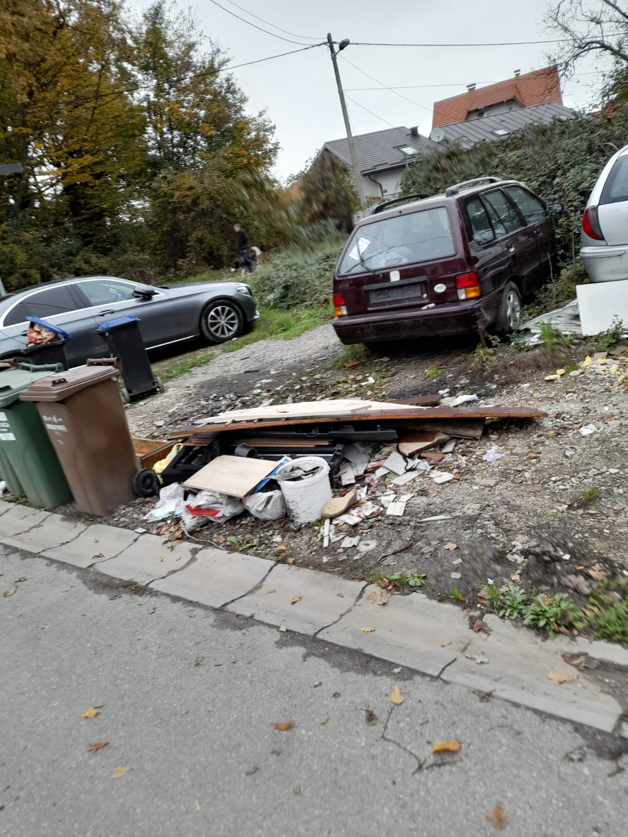

Slide 11
The extent of the waste disposal problem
The problem affects people who dispose of waste properly and people who dispose of waste improperly
Direct effect | Indirect effect
Occupies public space and it is not attract so see it | Pollutes the air
Limits the possibility of carrying out some other activities in that area | Causes health problems

Slide 12
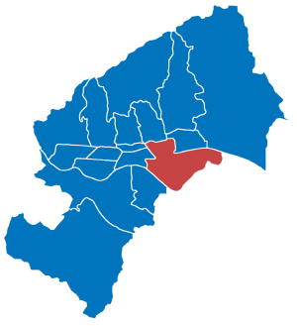
Teritory
Teritory that is affected is the entire area of Pešćenica – Žitnjak (the southeastern part of the city of Zagreb and an independent settlement Ivanja Reka)
In general, the whole Zagreb and all city districts are affected by this problem
The location of the city district Pešćenica – Žitnjak

Slide 13
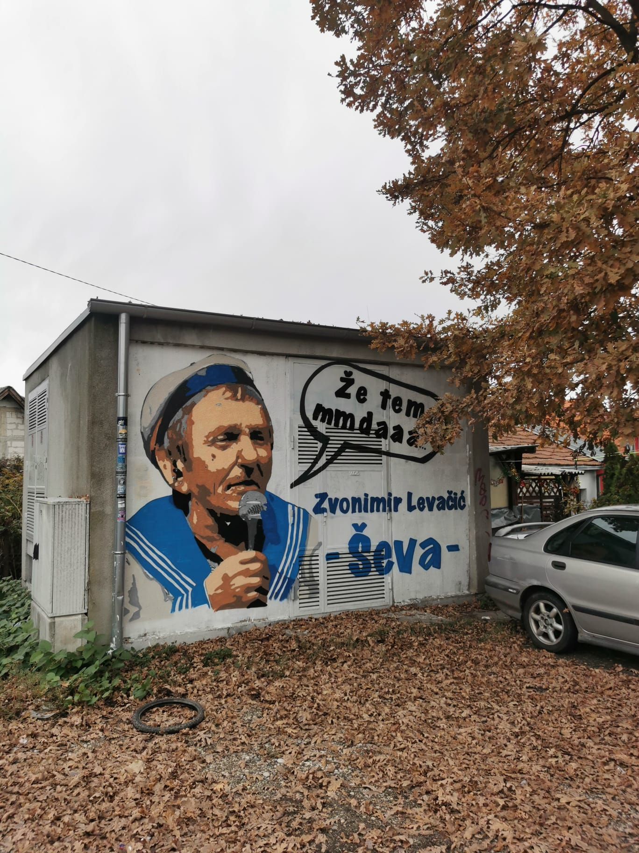
Social stability and values
Creates gap and divisions in society
It can be a cause of conflict between citizens
Cooperation between citizens can become difficult
Communication between neighbors can be disrupted
In general, social security can be threatened
The legend of Pešćenica, ,,The secretary of defence of Republic Pešćenica” Zvonimir Levačić

Slide 14
The origin of the problem
INDIVIDUAL
People are uninformed
Lack of education
People dont care
Lack of money
POLITICAL
Lack of motivation and lack of interest of the city government
Lack of resources to solve the problem
INSTITUTIONAL
Preoccupation of city regional offices with other problems
Bad cooperation and communication with residents
SOCIAL
Social exclusion
Stigmatization
Social media

Slide 15
Dynamics of the problem
DURATION
About 20 years ago, when Zagreb began to build and expand unplanned.
RATE
The problem is getting bigger, and the consequences are becoming more visible.
CONSEQUENCES
There are many consequences, such as dirty streets, the air is polluted, green areas are occupied, health problems occur and interpersonal relations are bad.
VARIABILITY
The problem is difficult to change and it is difficult to control its direction because waste disposal is left to the residents' own responsibility.

Slide 16
General goal of our project: Adequate waste management in Roma community
Specific goals of our project
Request form the local community to install more waste disposal containers
To improve the relationship and cooperation of city district councils and local committees with local community on the subject of waste management
Promotion of more positive opinions of local community about waste disposal in general
Promoting and raising awarness of the topic importance of waste disposal

Slide 17
Results that emerged from our specific goals
Request form the local community to install more waste disposal containers
1.1) established contact with representatives in local community and participated in meeting of the local committee where problems and solutions were discussed
1.2) a waste disposal building is made
2) To improve the relationship and cooperation of city district councils and local committees with local community on the subject of waste management
2.1) organised local committees that have collected waste together with citizens from their local communities
2.2) organizing gatherings of people from the local community with reprensetatives of city district councils and local commities, where through discussions, games and proposing ideas and solutions on the topic of waste disposal, they build a cooperative relationship

Slide 18
3) Promotion of more positive opinions of local community about waste disposal in general
3.1) publication of an article on social networks about the benefits of separating waste for nature and personal health
3.2) realization of the right to vouchers and prizes in the event of separation of waste by citizens in cooperation with local shops
4) Promoting and raising awarness of the topic importance of waste disposal
4.1) made a video about the importance of displaying waste and posted it in the Facebook group ,,Moja Volovčica”
4.2) 500 leaflets with educational content on waste disposal in the local community were distributed

