Slide 1
Effects of the enviormental factors on daily life of children with disabilities and their families
Students: Lucija Jezernik, Lorena Burčul, Antonia Brajković, Silvija Grahovac
Professor: prof. dr. sc. Ana Opačić
Social work in the comunity,
Study center of social work,
Zagreb Faculty of Law

Slide 2
Contents table:
Children with disabilities
City of Zagreb, Croatia
City of Zagreb, Lower town
Traffic and transportation
Noise and light pollution
Earthquake and flood
Public places and state institutions
Social security and health
Education
Free time
Conclusion

Slide 3
Children with disabilities

Slide 4
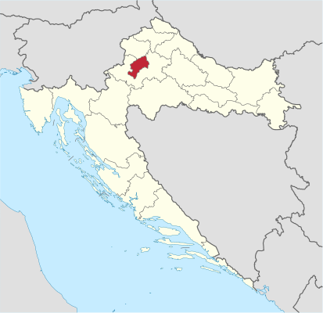
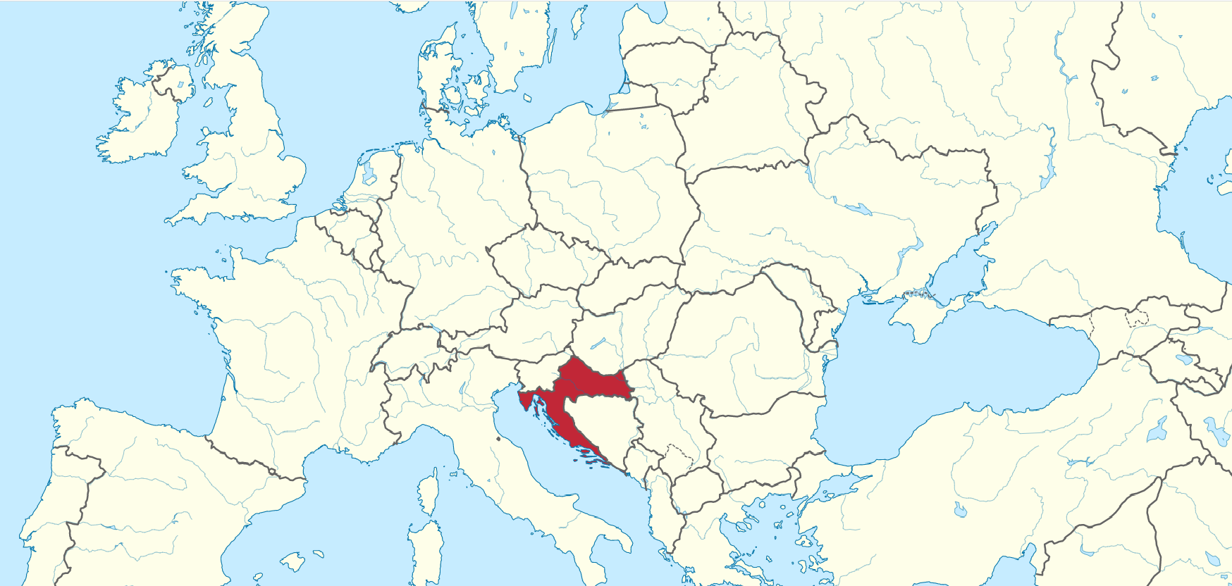
City of Zagreb, Croatia
Croatia on a map of Europe
Zagreb on a map of Croatia

Slide 5
City of Zagreb, Lower town

Slide 6
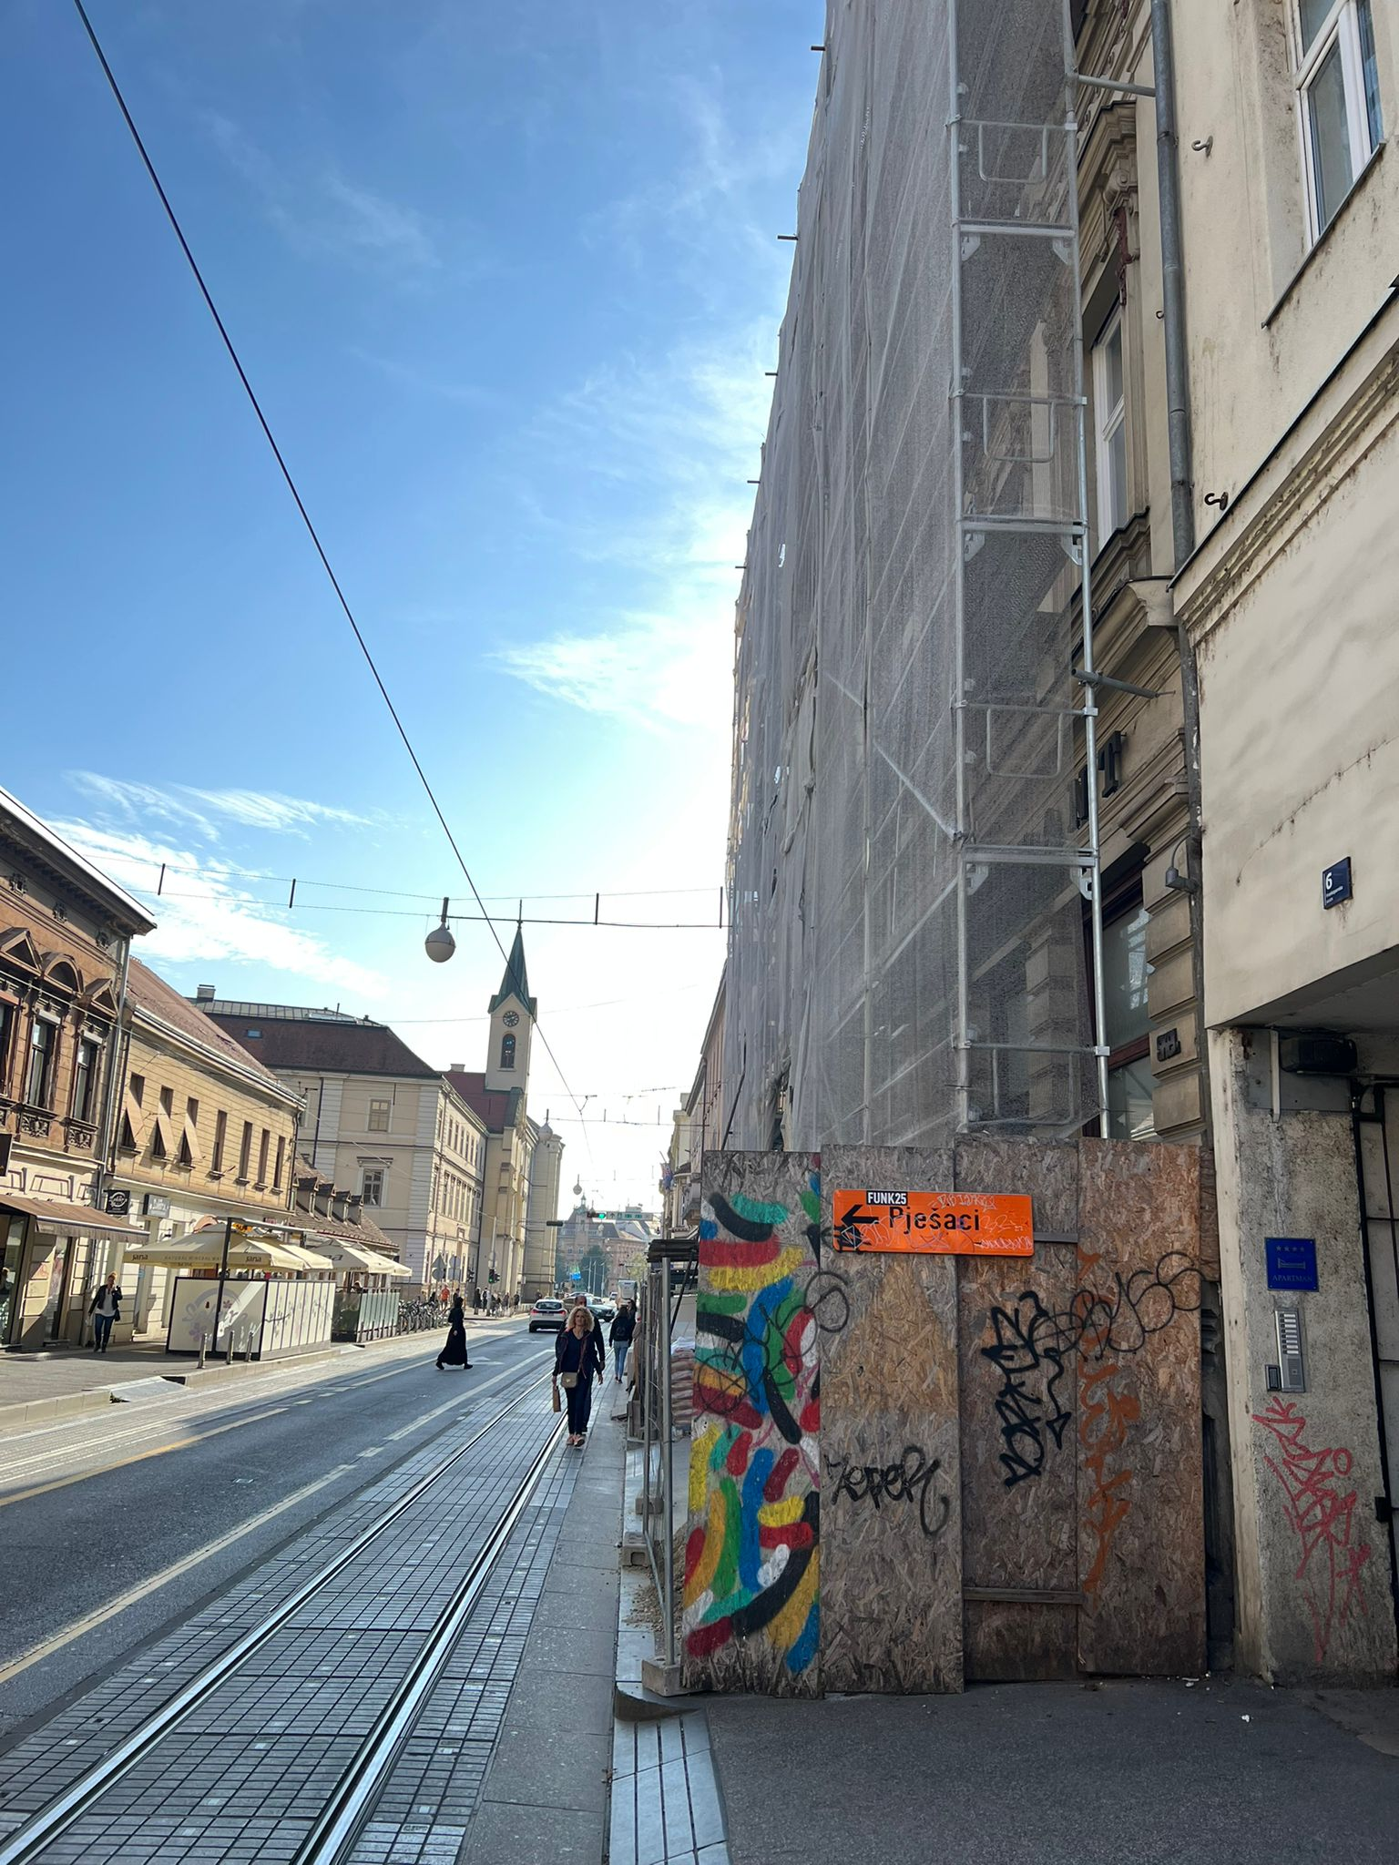
Traffic and transportation

Slide 7
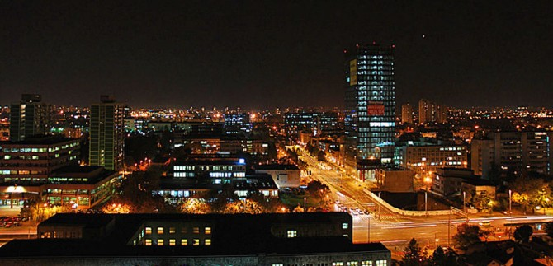
Noise and light pollution

Slide 8
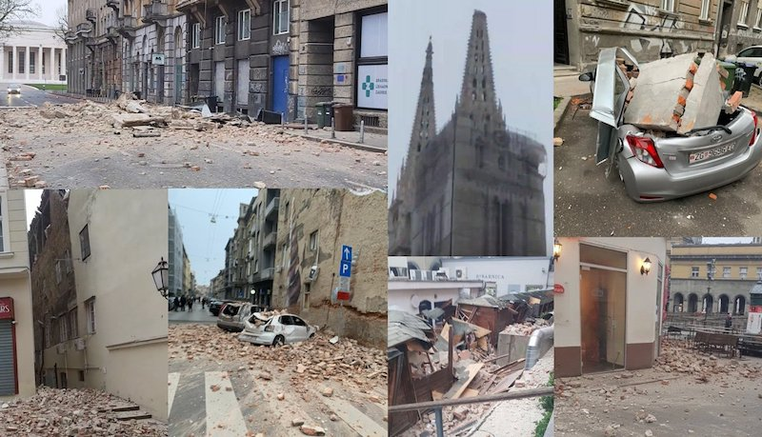
Earthquake and flood

Slide 9
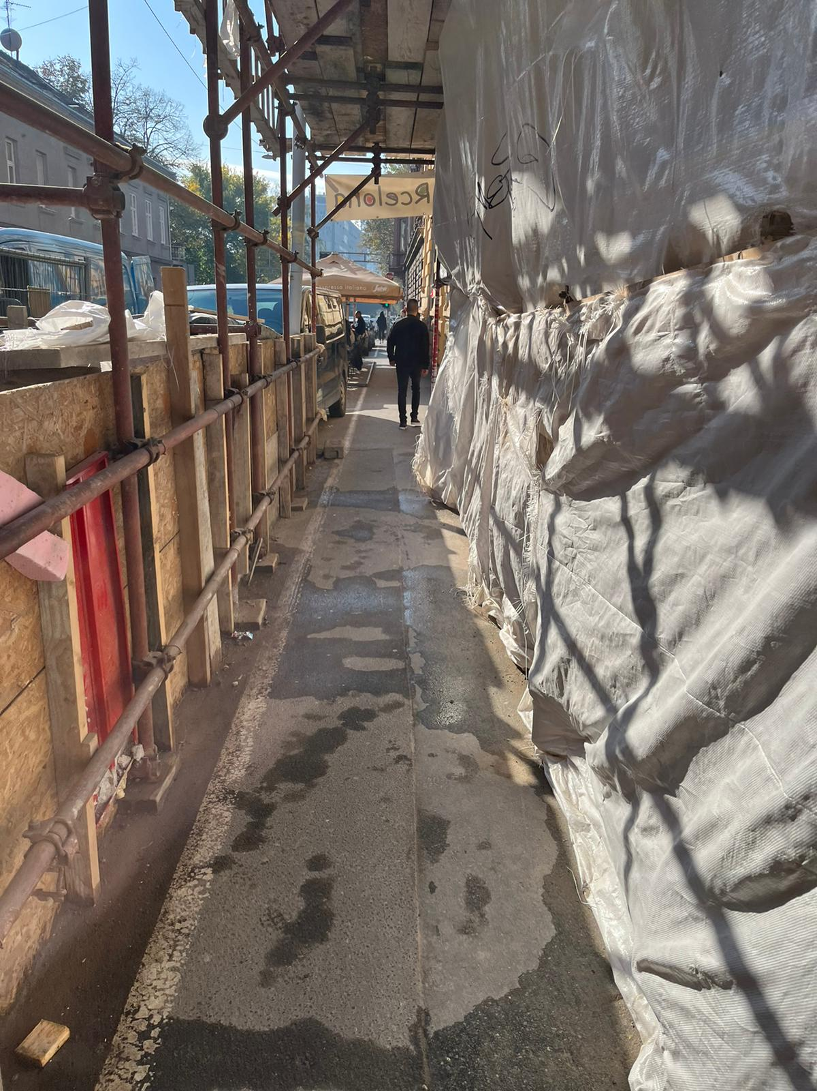
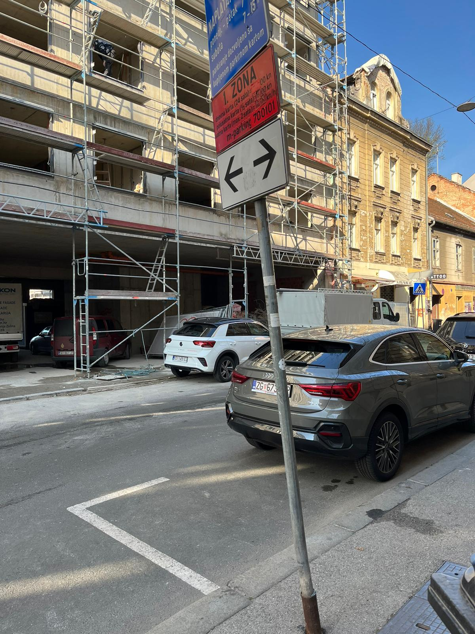
Earthquake and flood

Slide 10
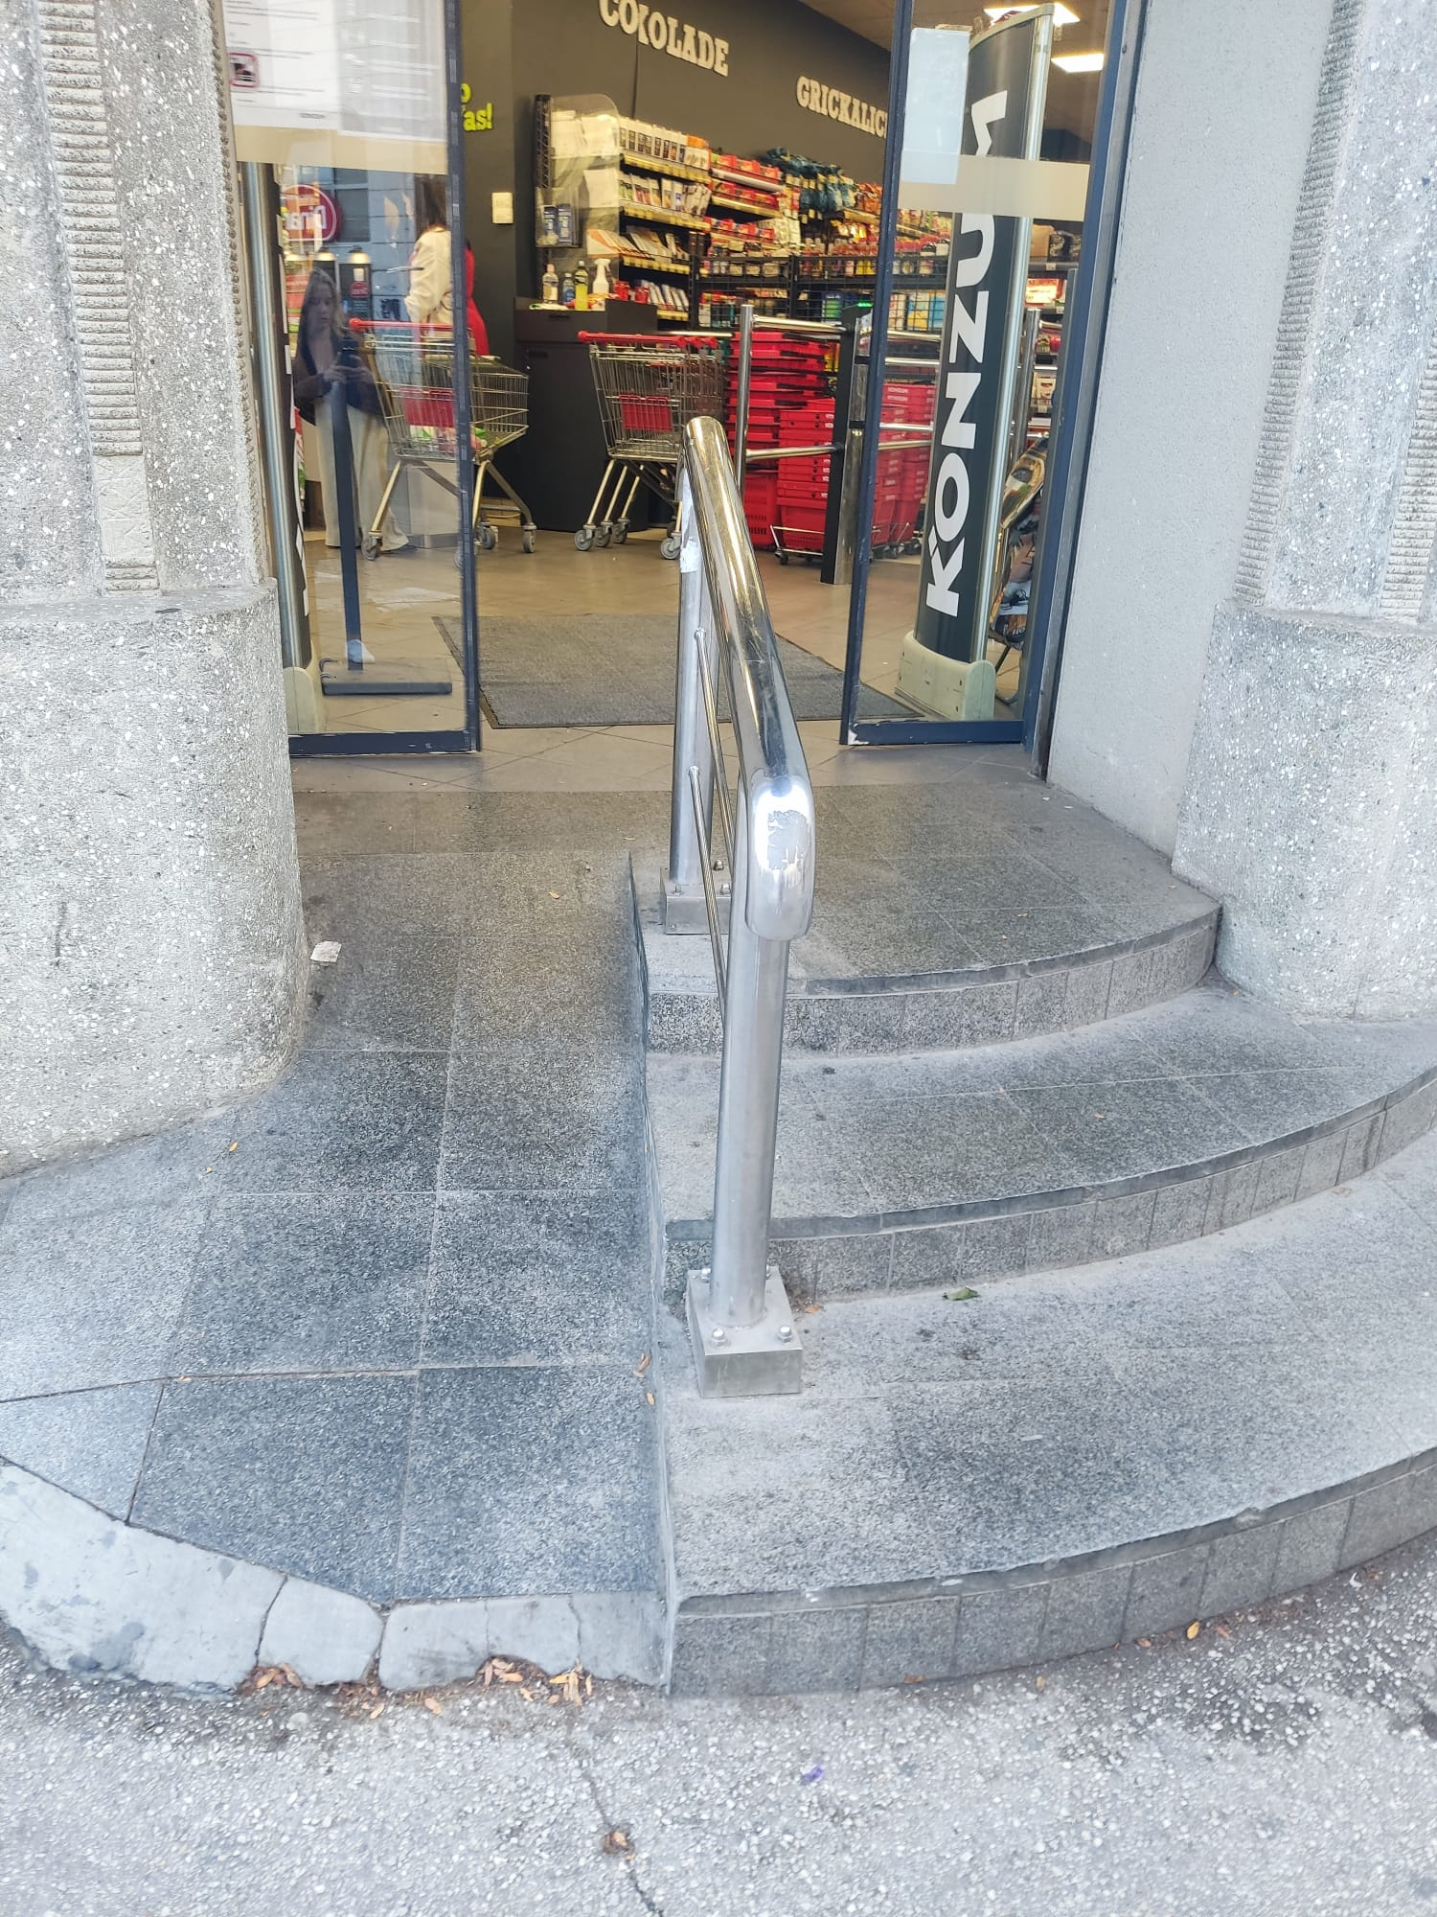
Public places and state institutions

Slide 11
Social security and health

Slide 12
Education

Slide 13
Free time

Slide 14
Conclusion

Slide 15
THANK YOU FOR YOUR ATTENTION!

