Slide 1
Introduction
Michele Murgia Education coordinator AI Erasmus University Rotterdam LinkedIn

Slide 2
Generative AI in academia
AI; two definitions of intelligence:
1. Mind
2. Information gathering and processing
Reception:
Plagiarism/ghost writing
Spurring education: the ChatGPT effect

Slide 3
Using LLMs, e.g. ChatGPT (students, teachers and researchers)
Research guidance: e.g. ‘what academic resources could I use to research the ethics of ChatGPT for university students?’
Brainstorming: e.g. ‘I have to think about a course outline about the political dimension of AI. Can you give me some starters?’
Understanding: e.g. ‘The text I just copy-pasted talks about ‘’epistemic harm’’, but I don’t get it. Could you summarise it in an understandable way?’
Proofreading: have it read for grammatical errors, potential issues with readability, and provide suggestions for improvement.
Cite the LLM as a reference when used.

Slide 4
GPT model is about text
Transformer: determining the probability of word or visual order
Pre-trained: Uses enormous amounts of data
Generative: Generates output that seems new and human

Slide 5
Issues
Biased
Partial data (anglosphere)
False information
Privacy
Different legislations
Environmental harm
Copyright infringement
Confidentiality
Closed source

Slide 6
An alternative to ChatGPT: Erasmian Language Model

Slide 7
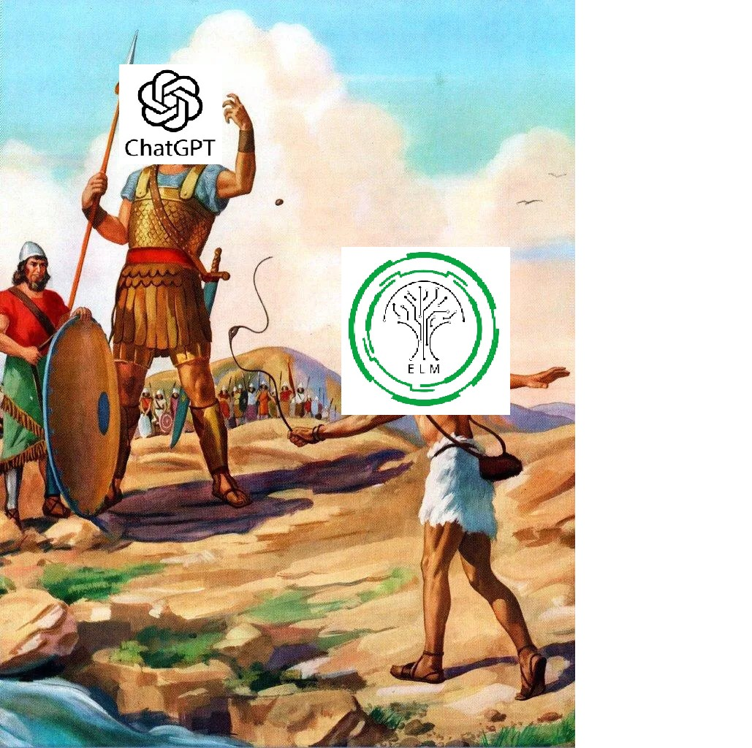
ELM: by, with and for academia
Open source
Privacy guaranteed
Limited environmental harm
Trained in Dutch and English (contexts)
Future:
Less bias
Based on community input

Slide 8
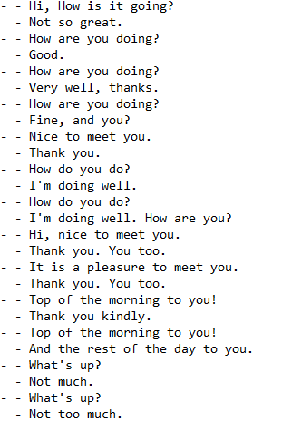
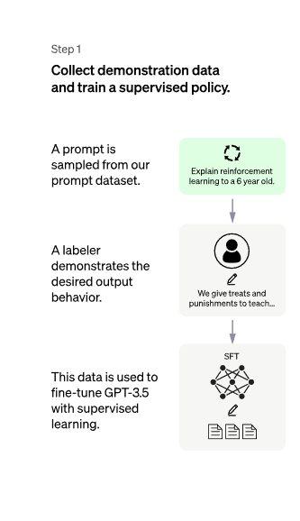
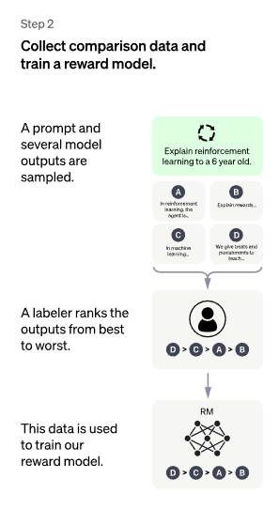
Supervised learning (chat)
Instructing the algorithm via examples

Slide 9
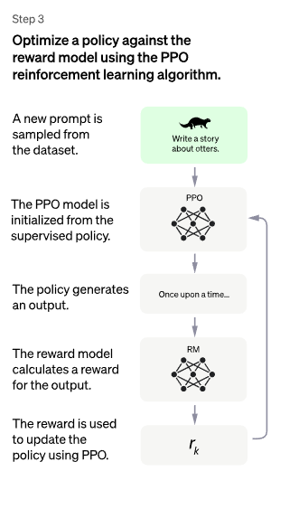
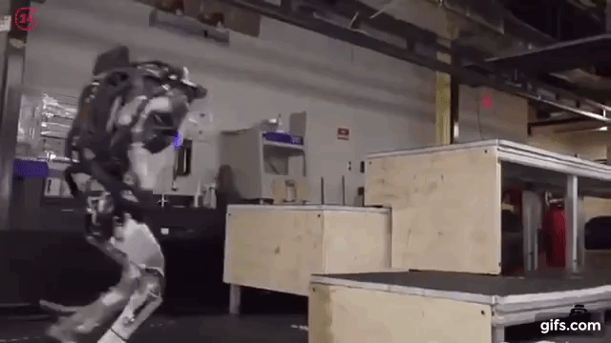
Reinforcement learning (exploring actions)

Slide 10
Q&A
Thank you!
ELM launch 9 October (Netherlands)
https://www.eventbrite.nl/e/712945989647?aff=oddtdtcreator

